Slide 1
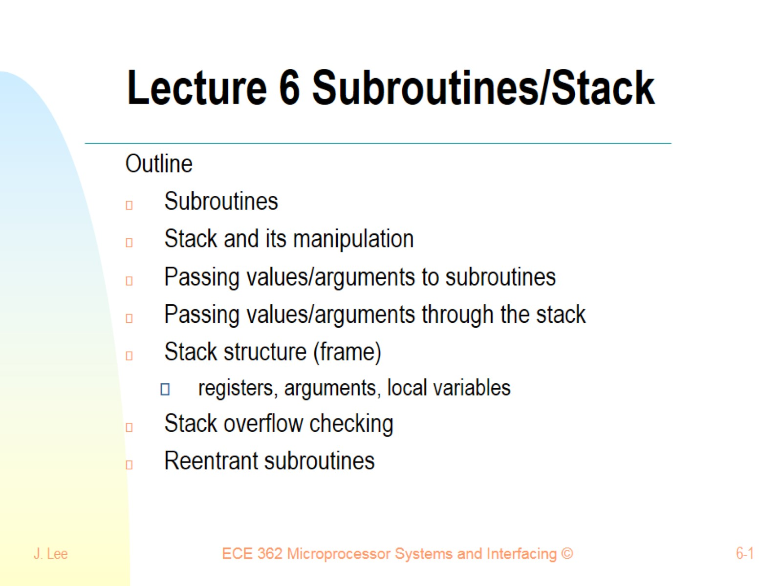
Lecture 6 Subroutines/Stack

Slide 2
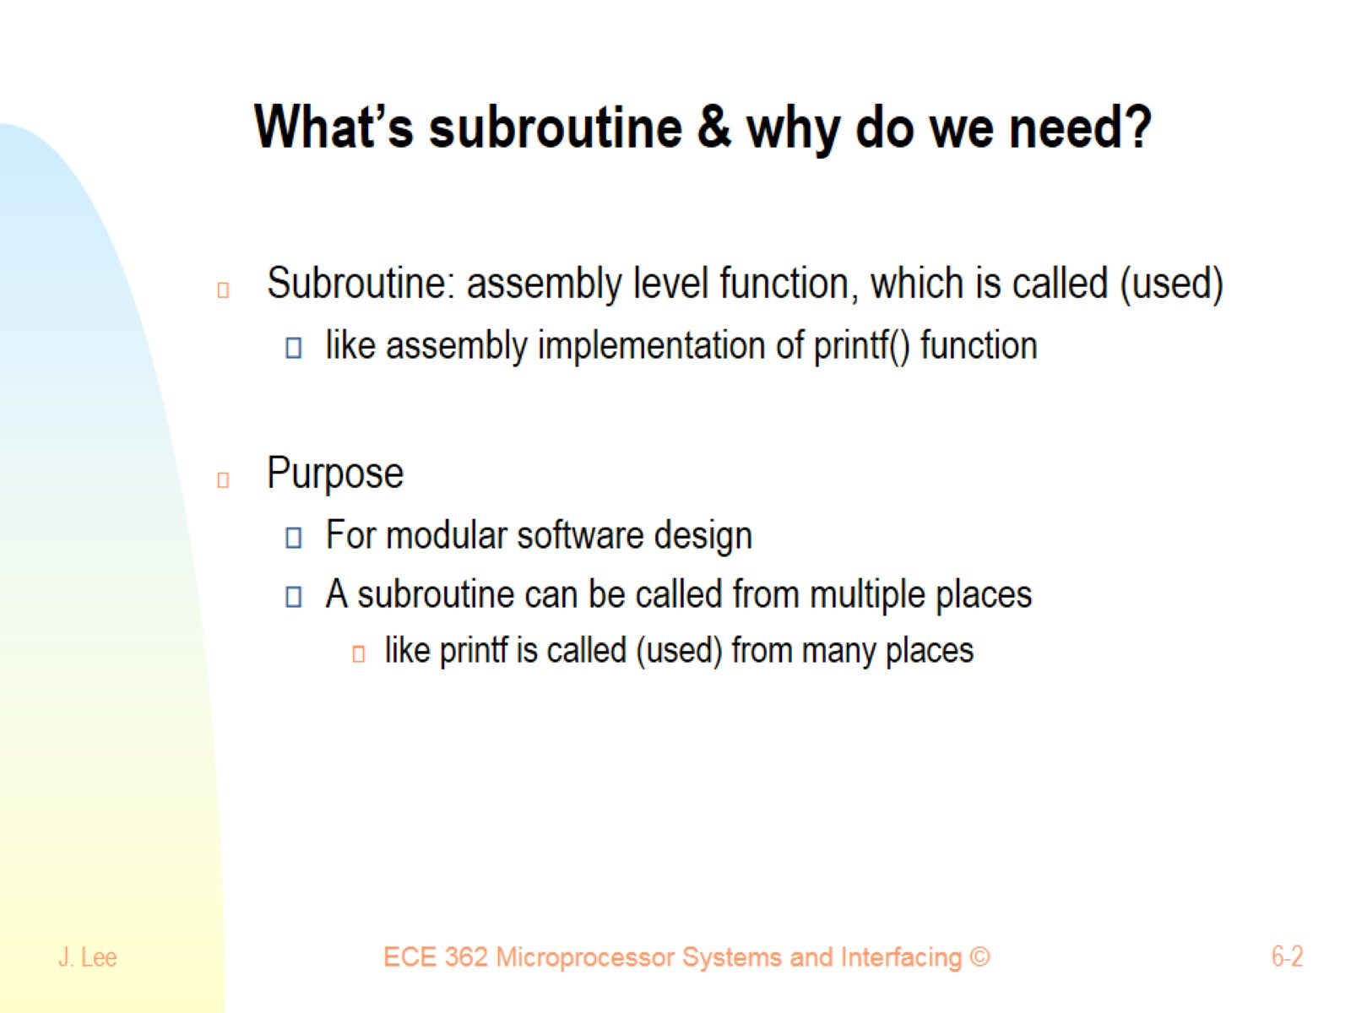
What’s subroutine & why do we need?

Slide 3
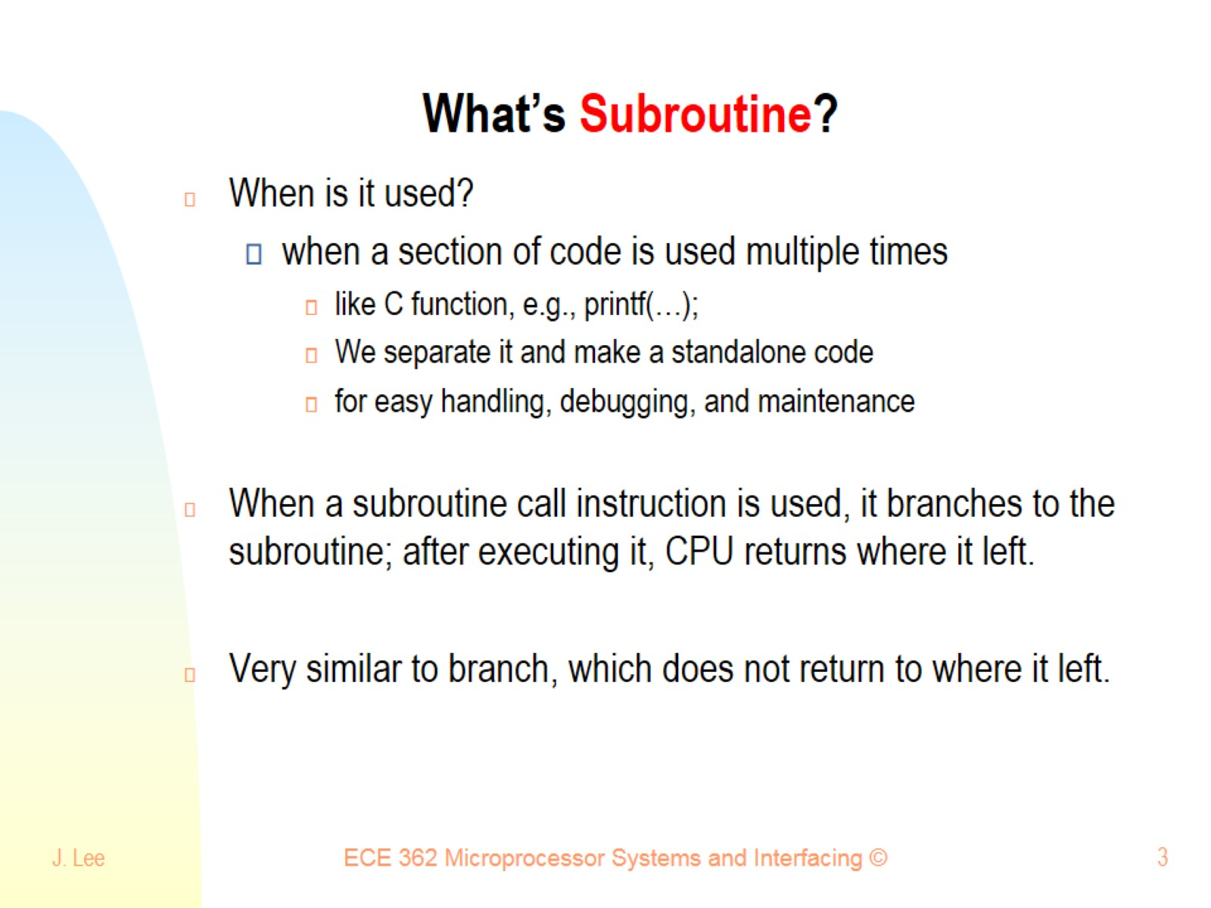
What’s Subroutine?

Slide 4
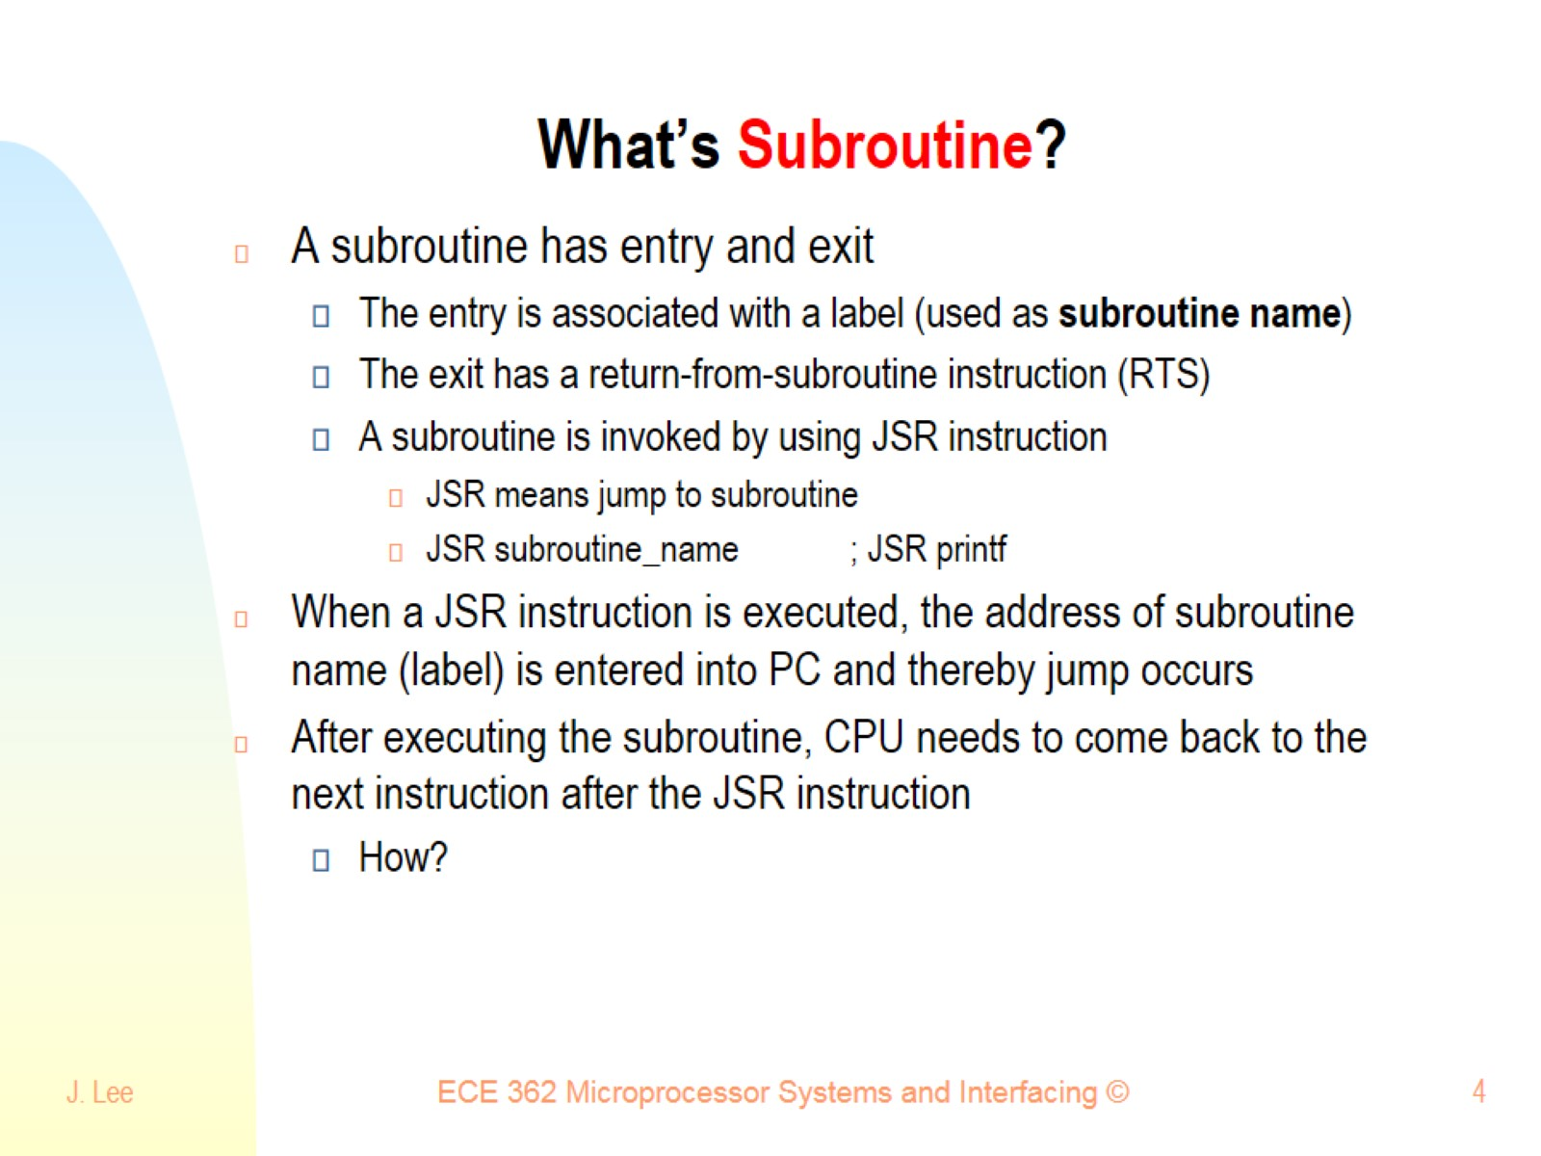
What’s Subroutine?

Slide 5
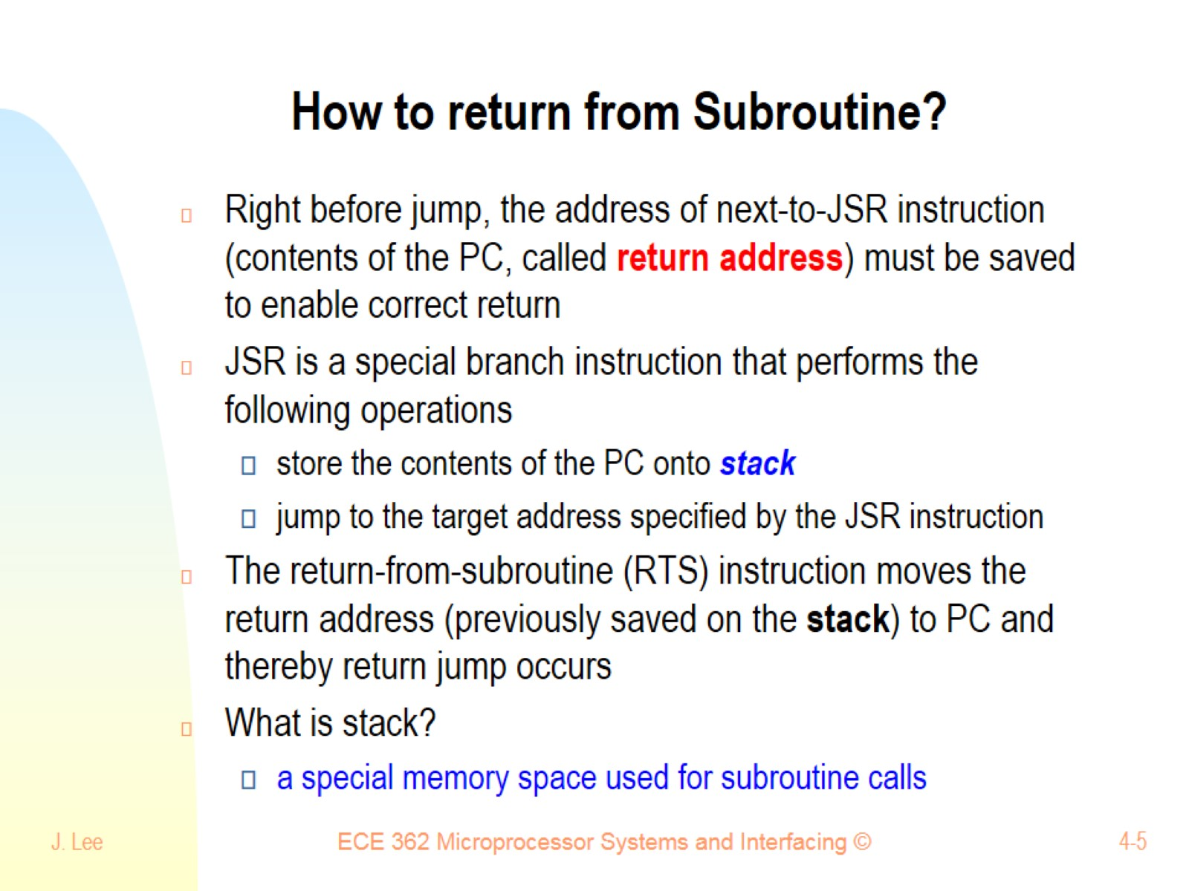
How to return from Subroutine?

Slide 6
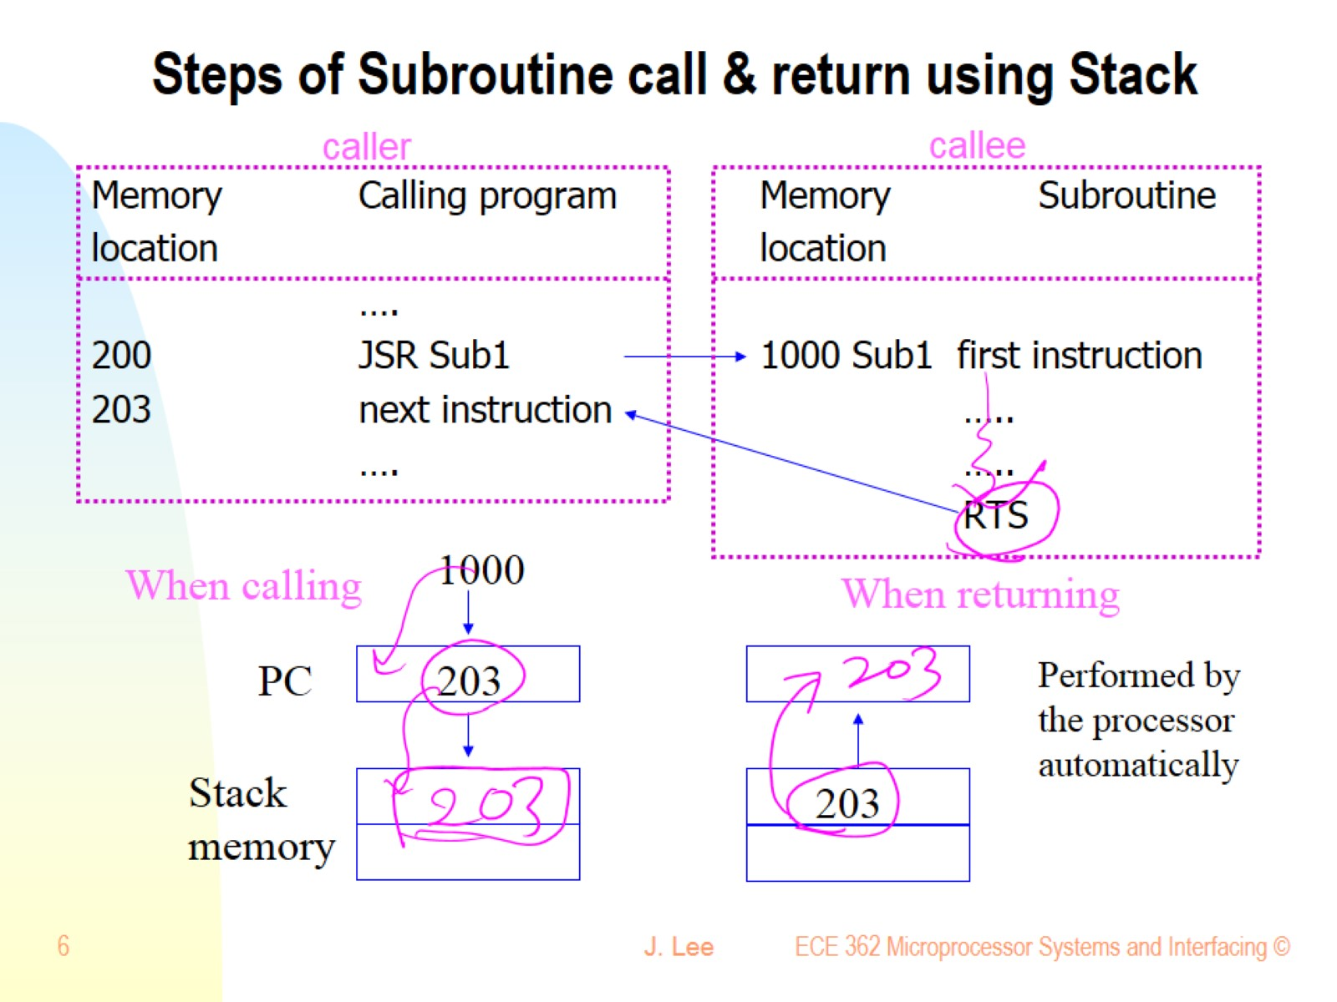
Steps of Subroutine call & return using Stack

Slide 7
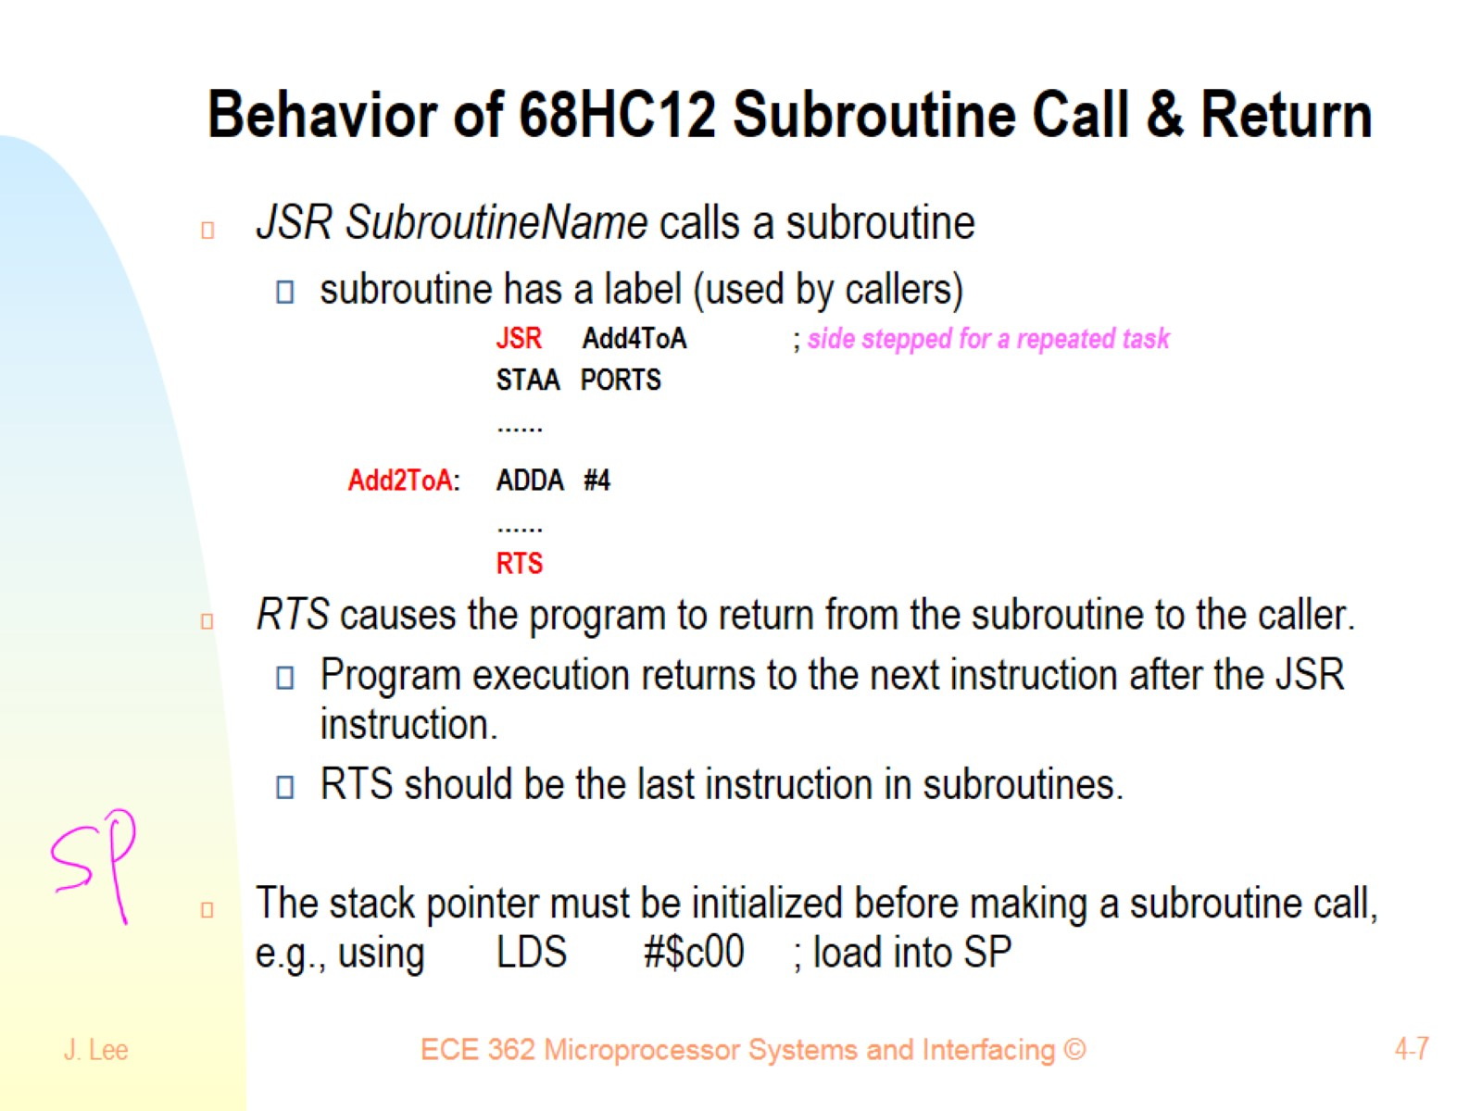
Behavior of 68HC12 Subroutine Call & Return

Slide 8
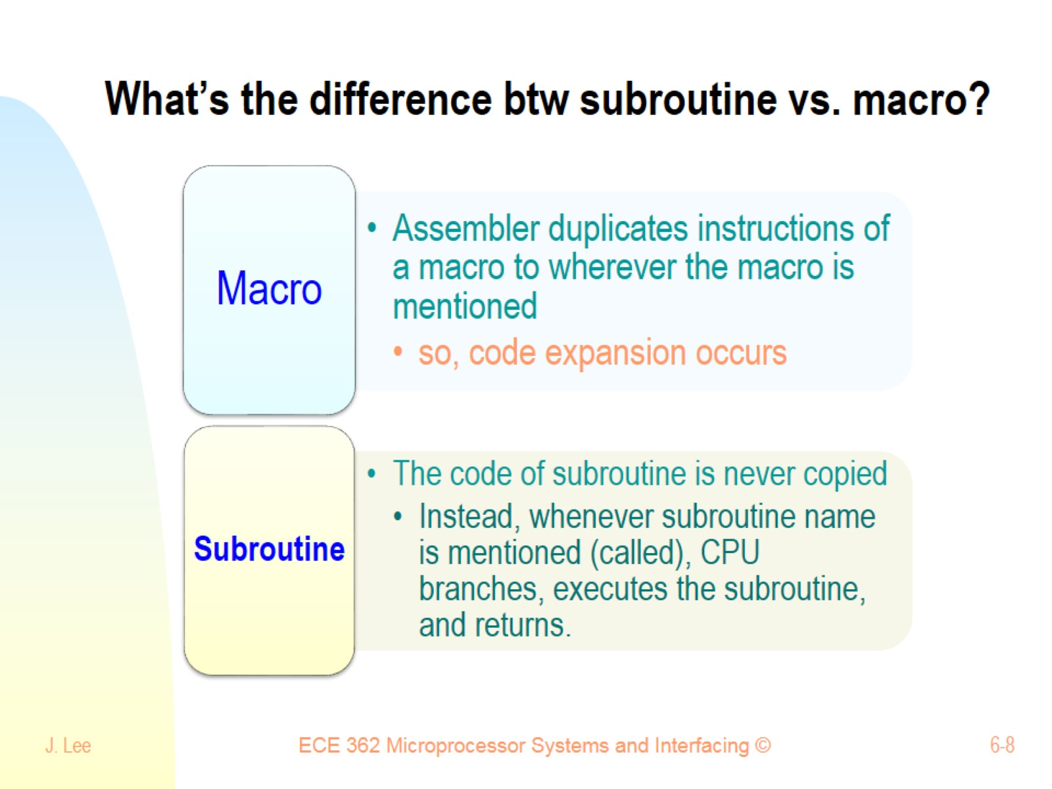
What’s the difference btw subroutine vs. macro?

Slide 9
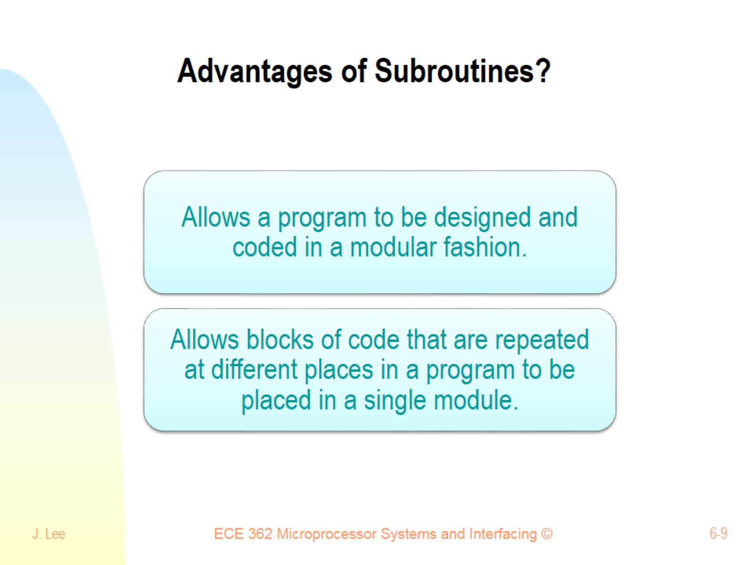
Advantages of Subroutines?

Slide 10
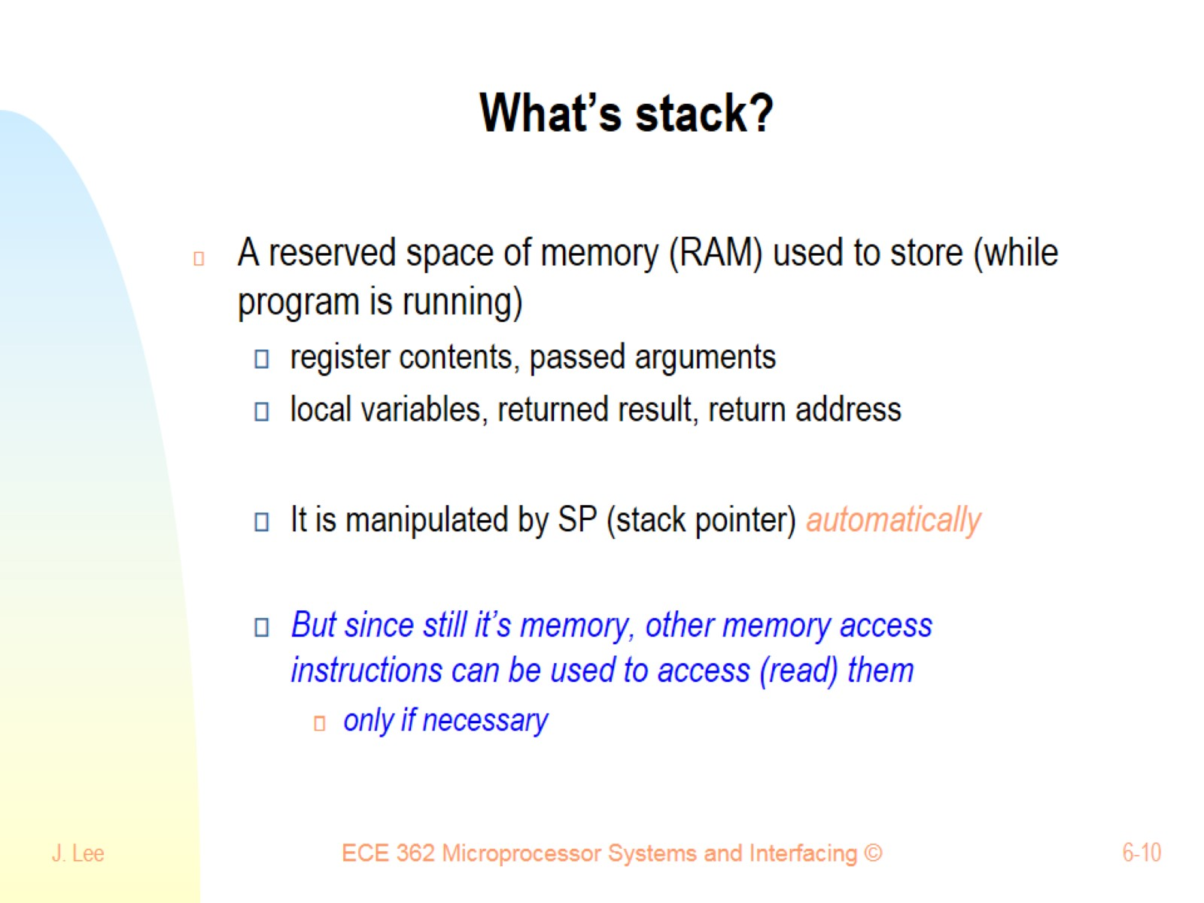
What’s stack?

Slide 11
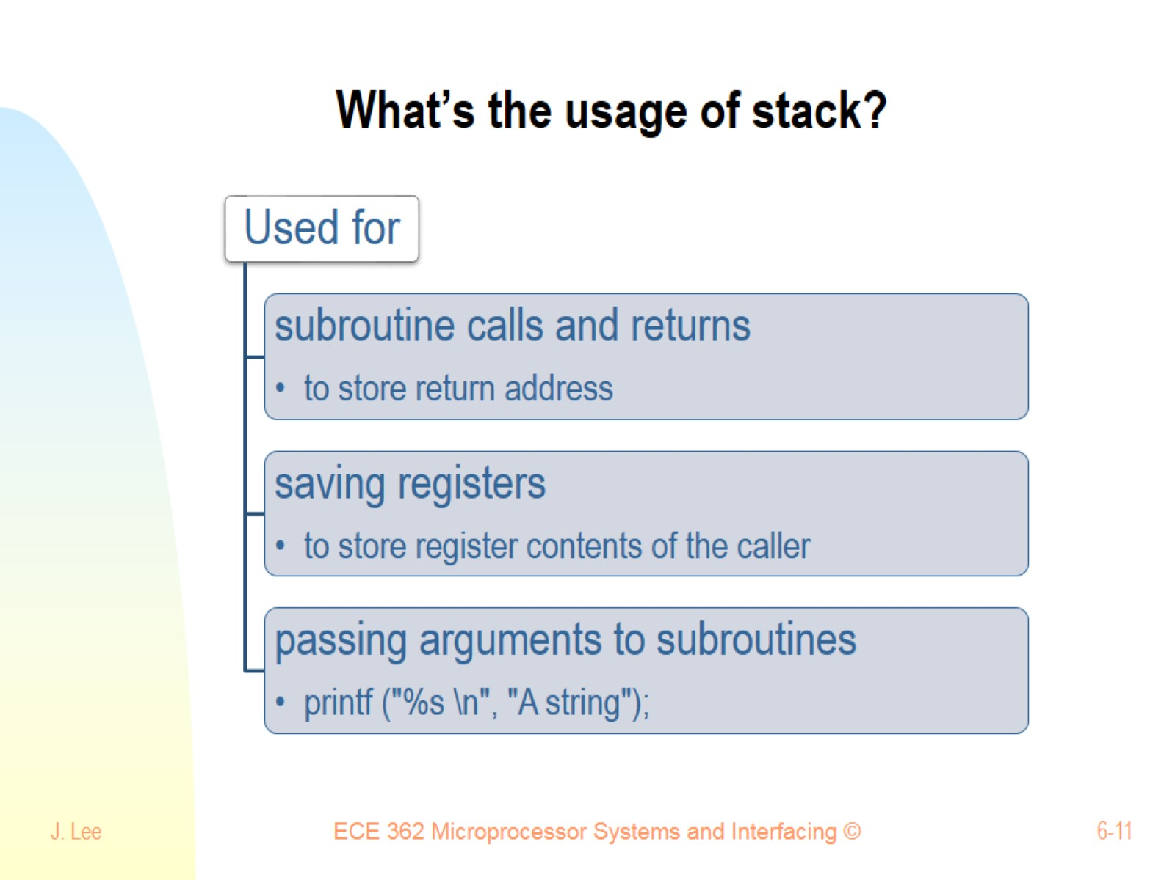
What’s the usage of stack?

Slide 12
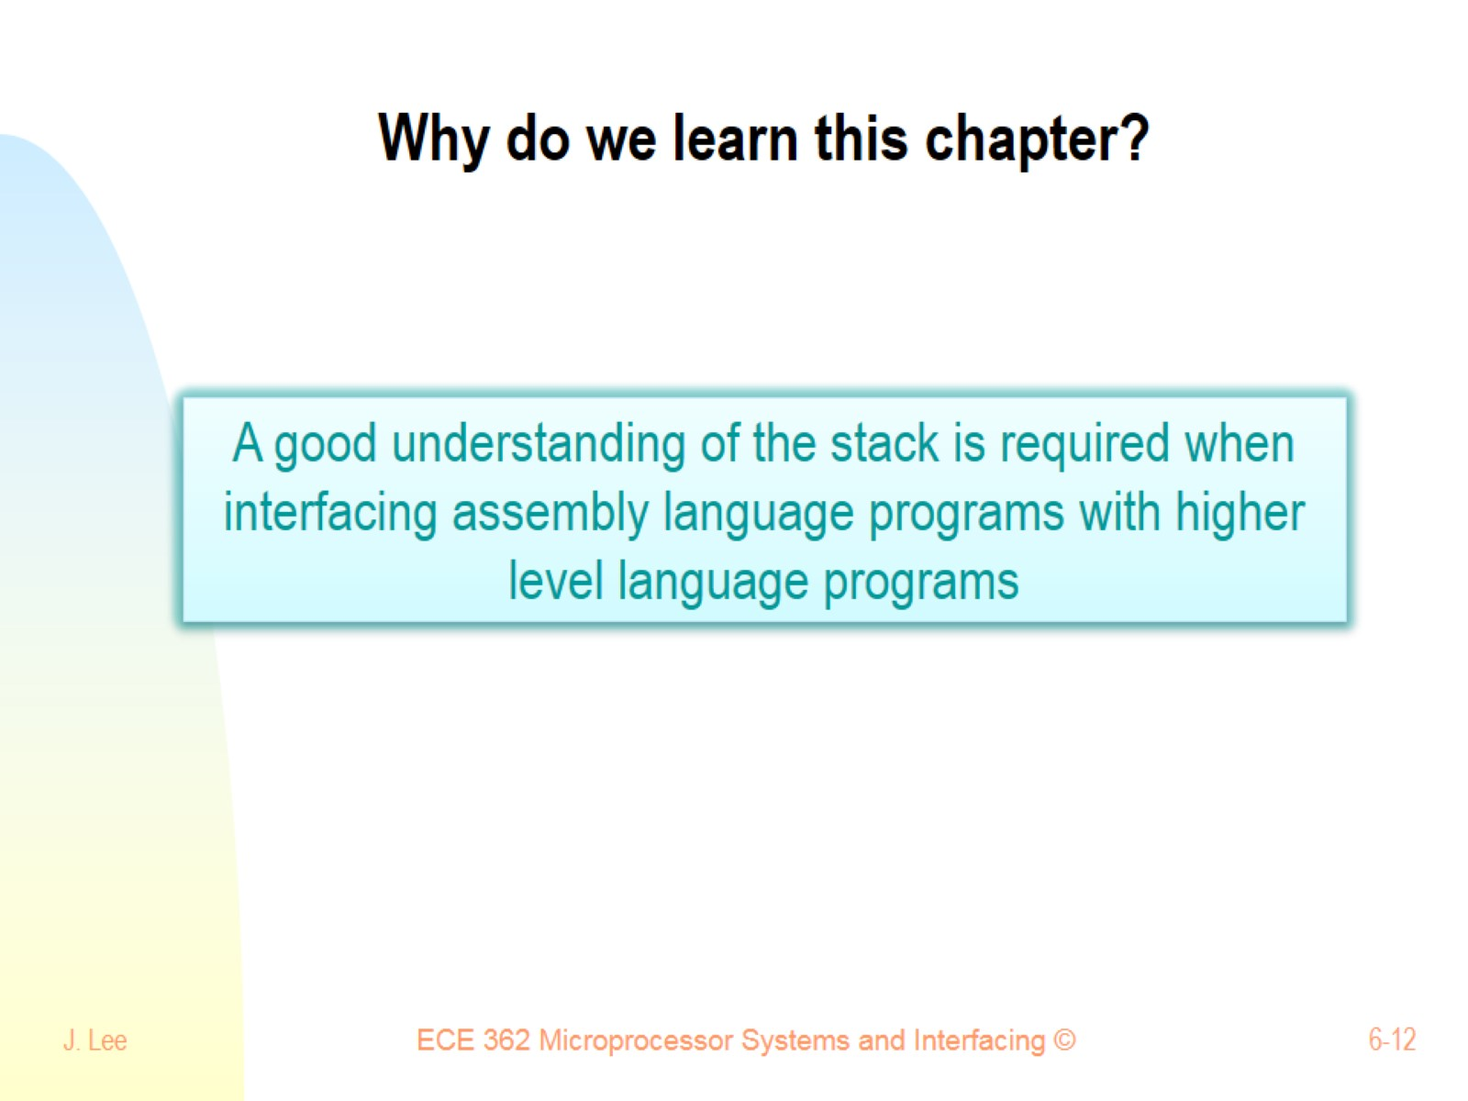
Why do we learn this chapter?

Slide 13
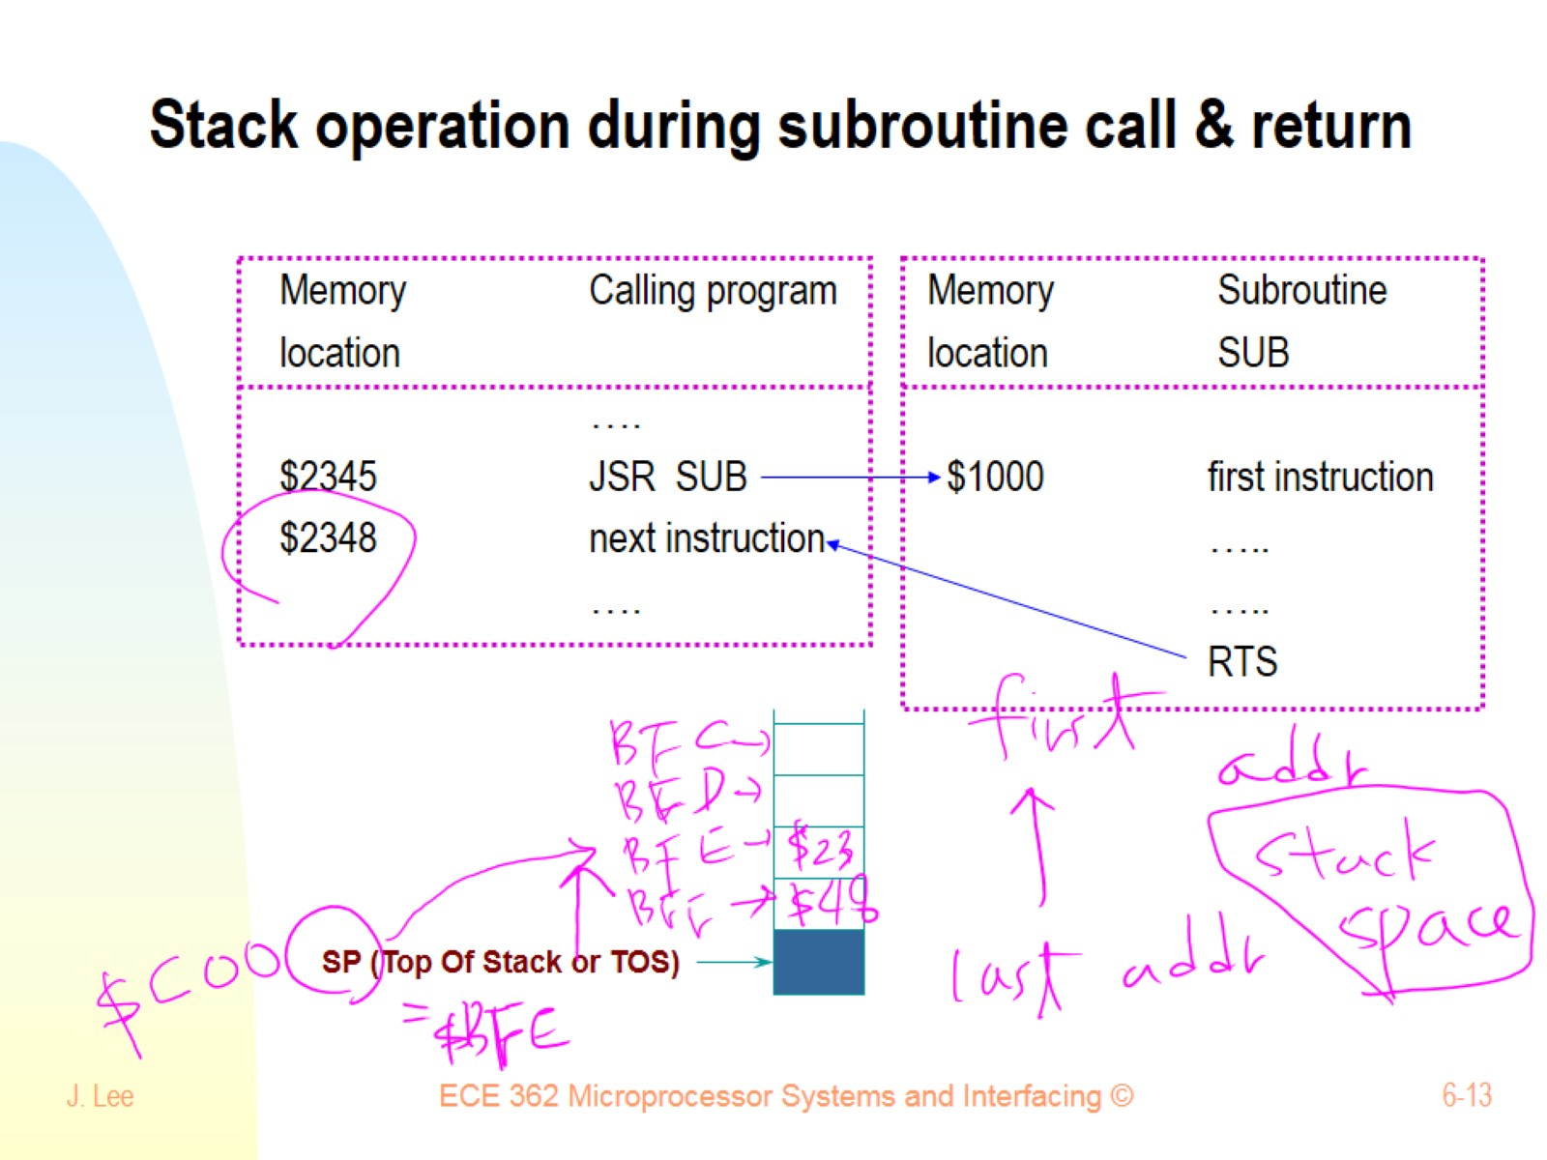
Stack operation during subroutine call & return

Slide 14
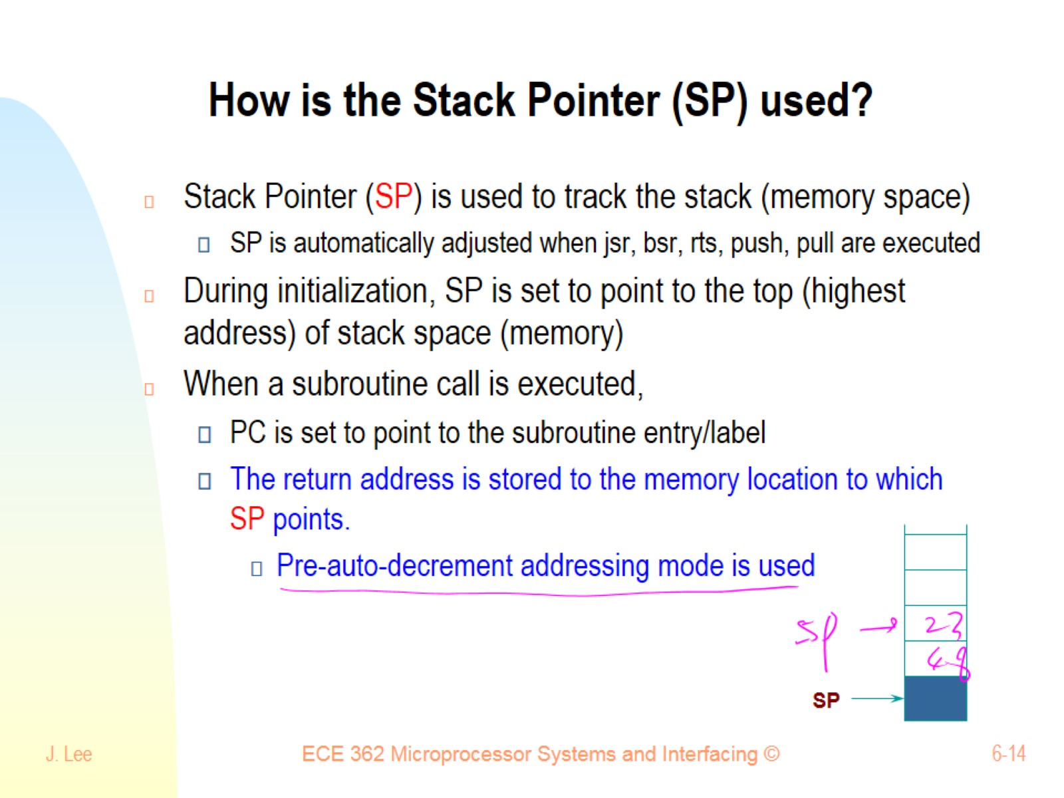
How is the Stack Pointer (SP) used?

Slide 15
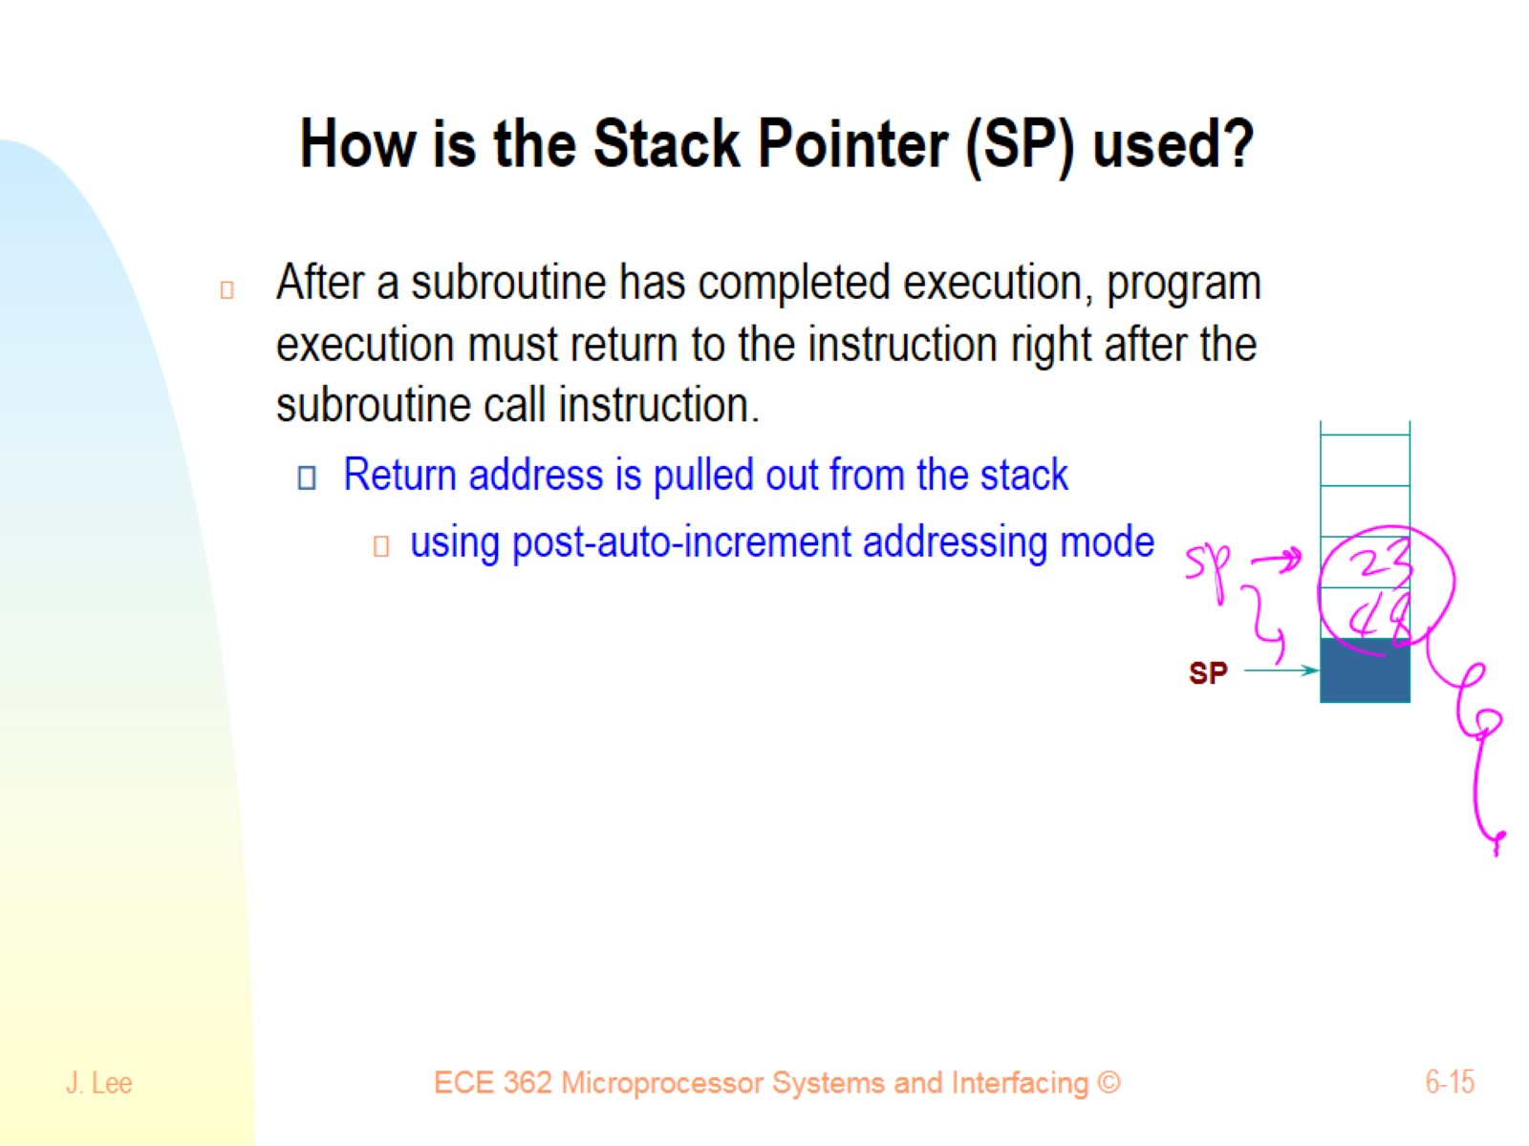
How is the Stack Pointer (SP) used?

Slide 16
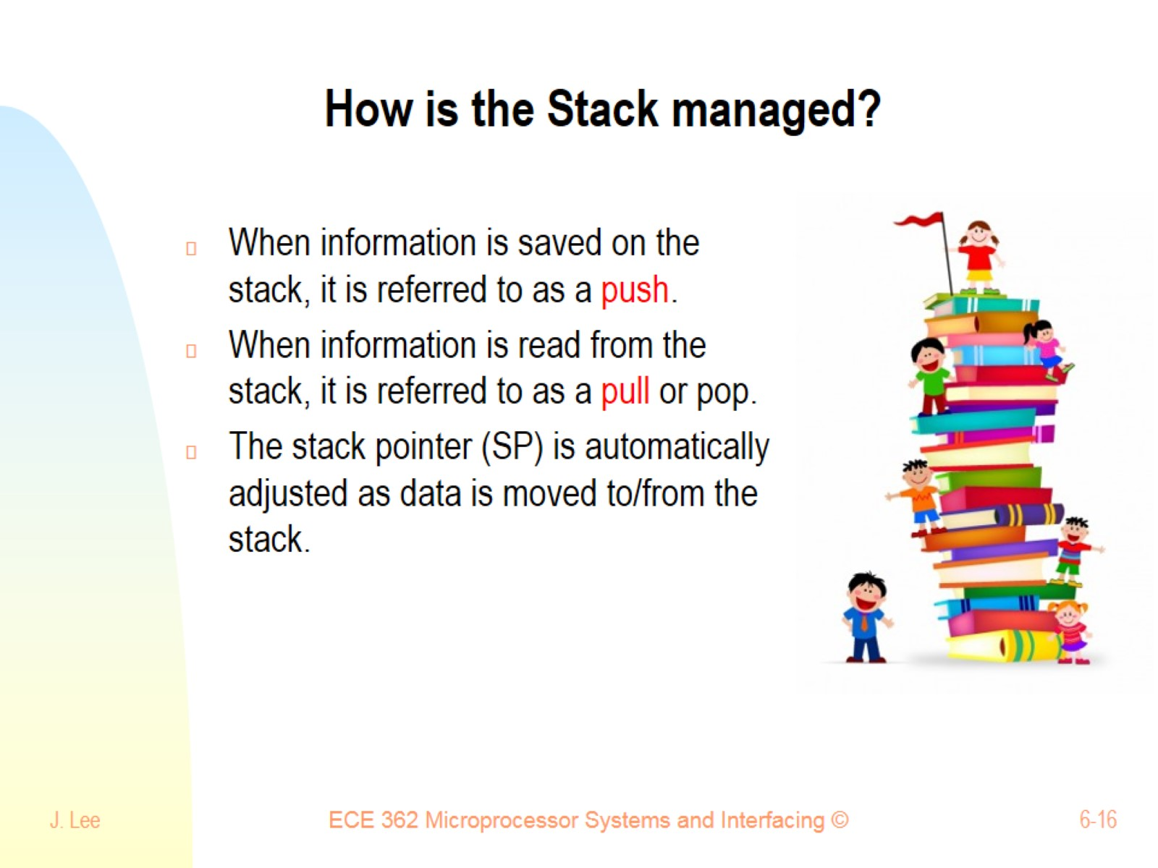
How is the Stack managed?

Slide 17
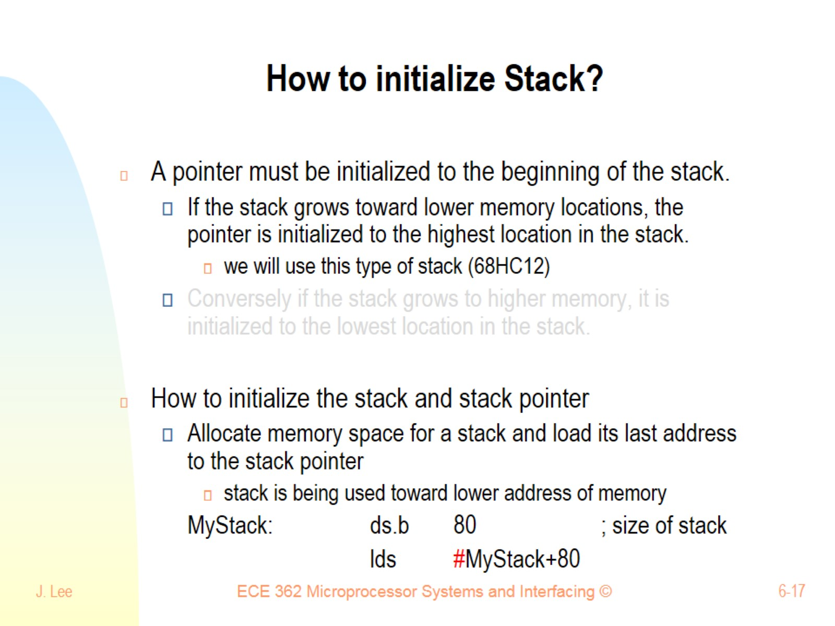
How to initialize Stack?

Slide 18
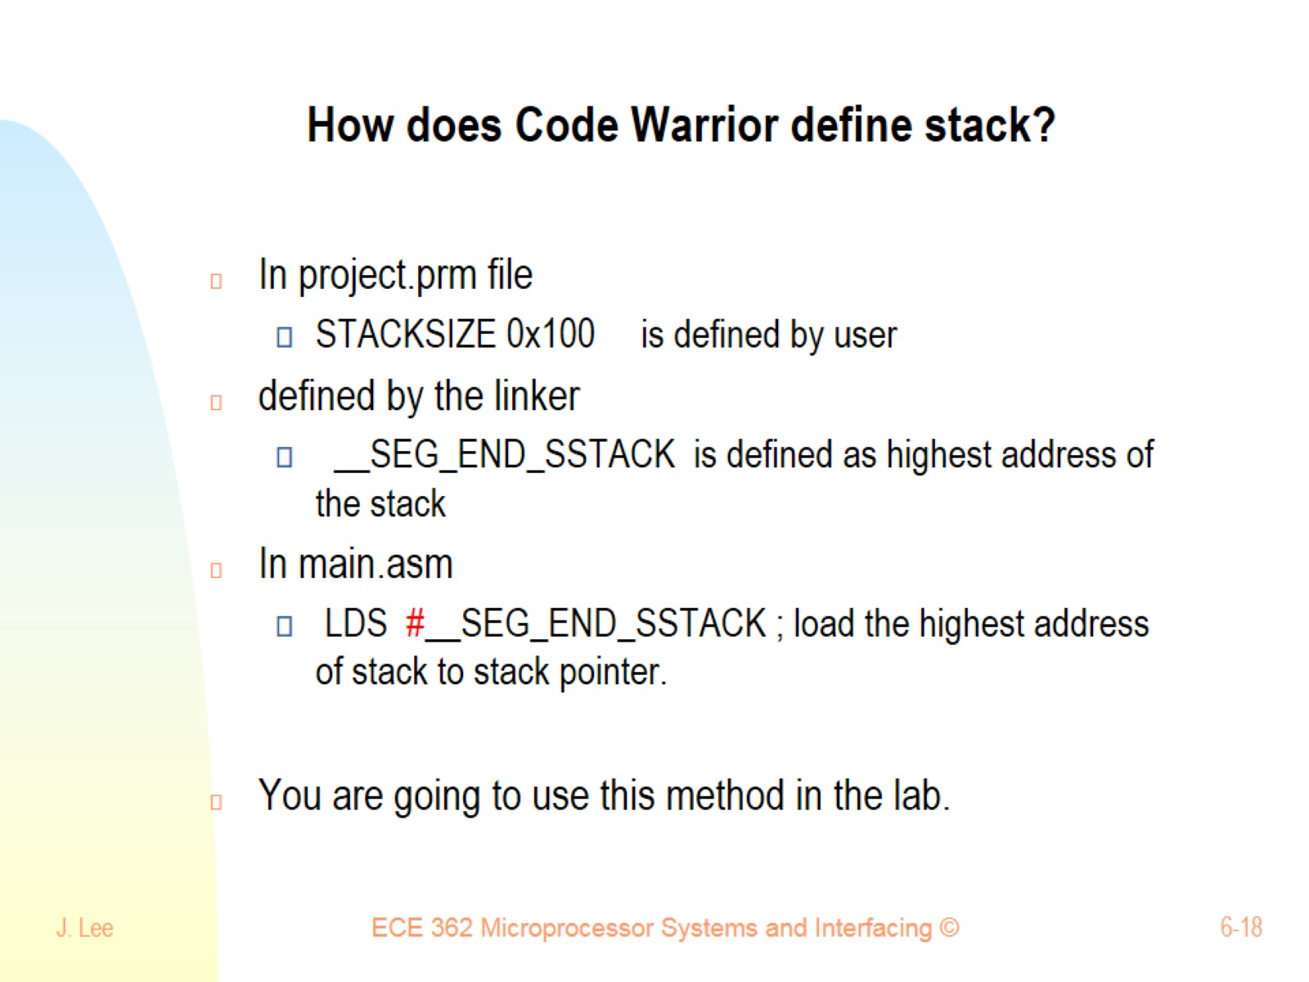
How does Code Warrior define stack?

Slide 19
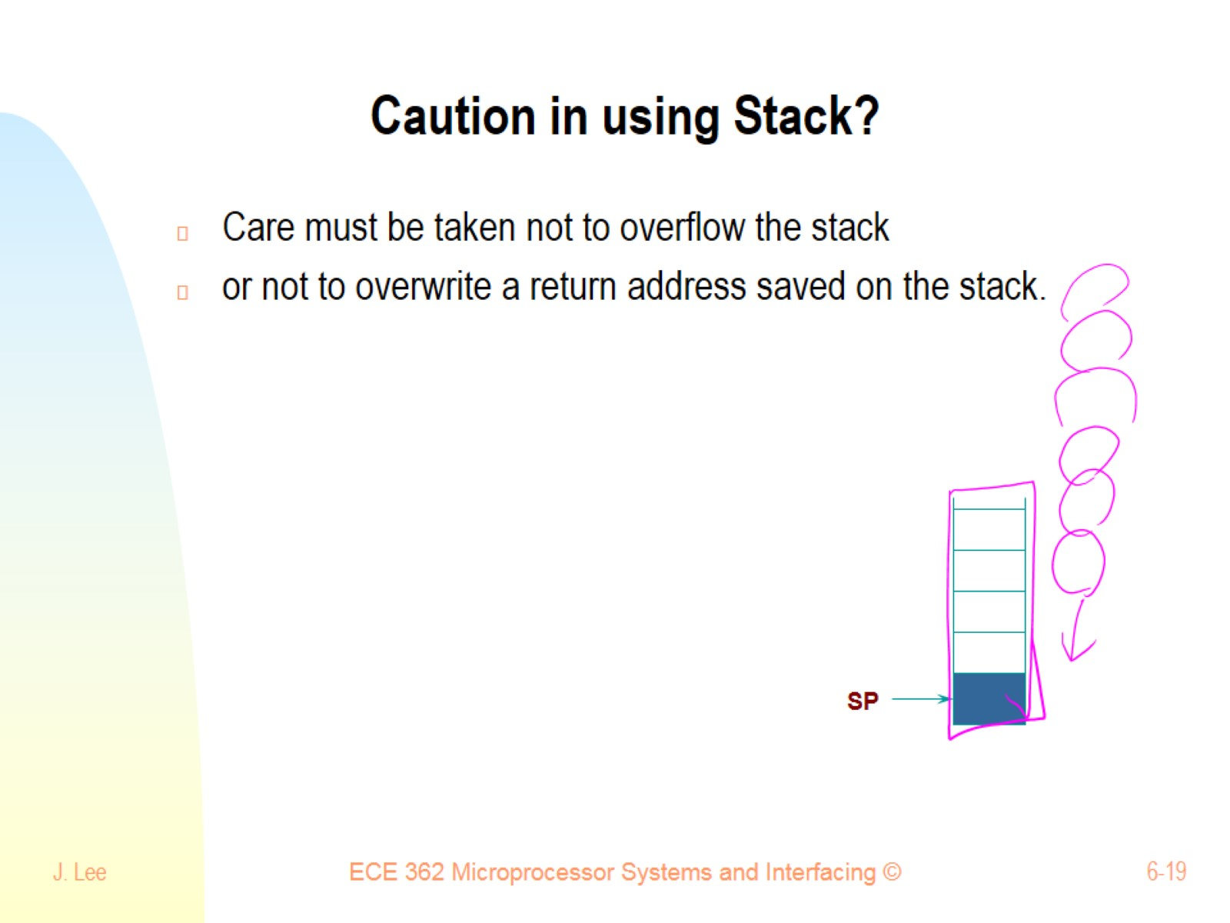
Caution in using Stack?

Slide 20
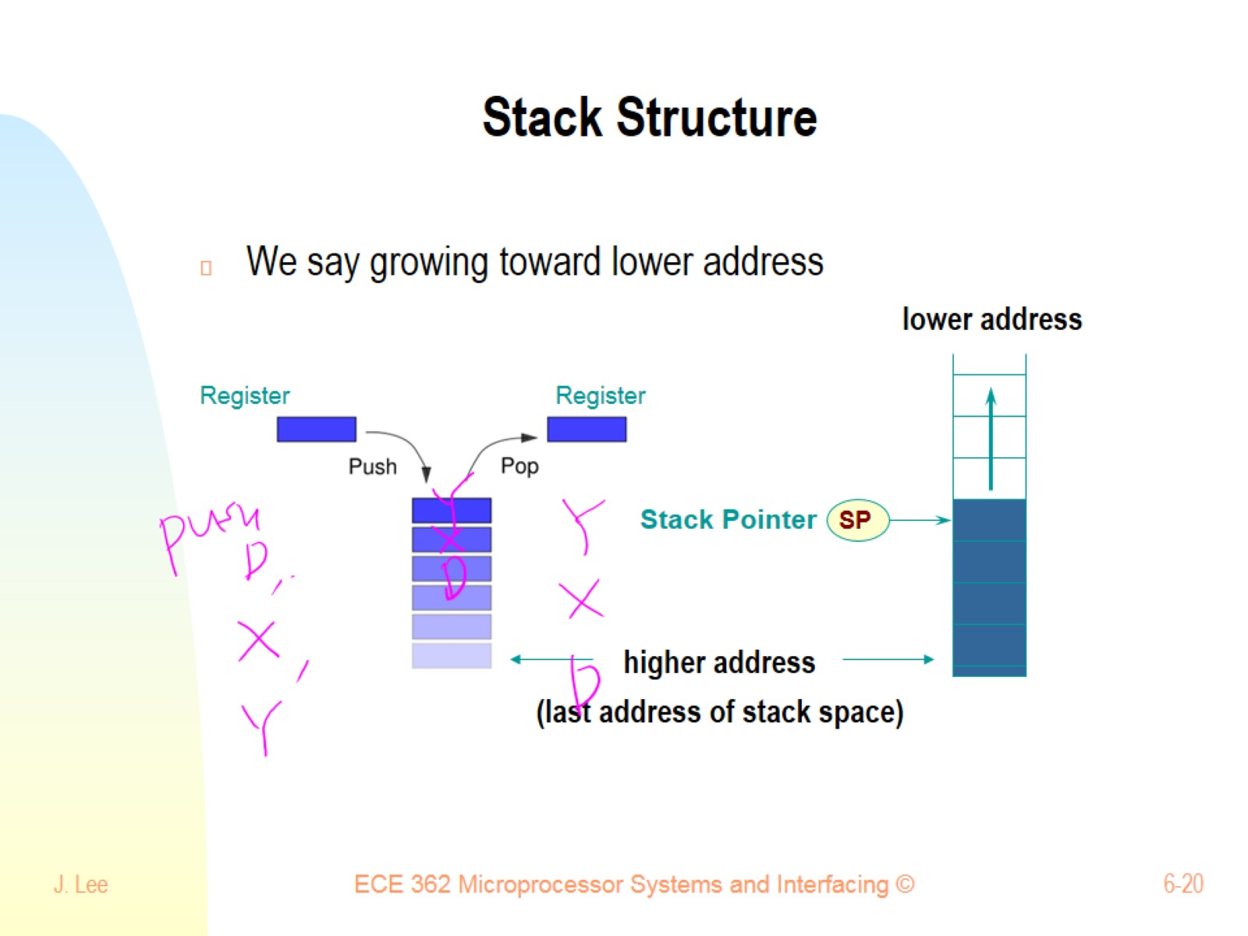
Stack Structure

Slide 21
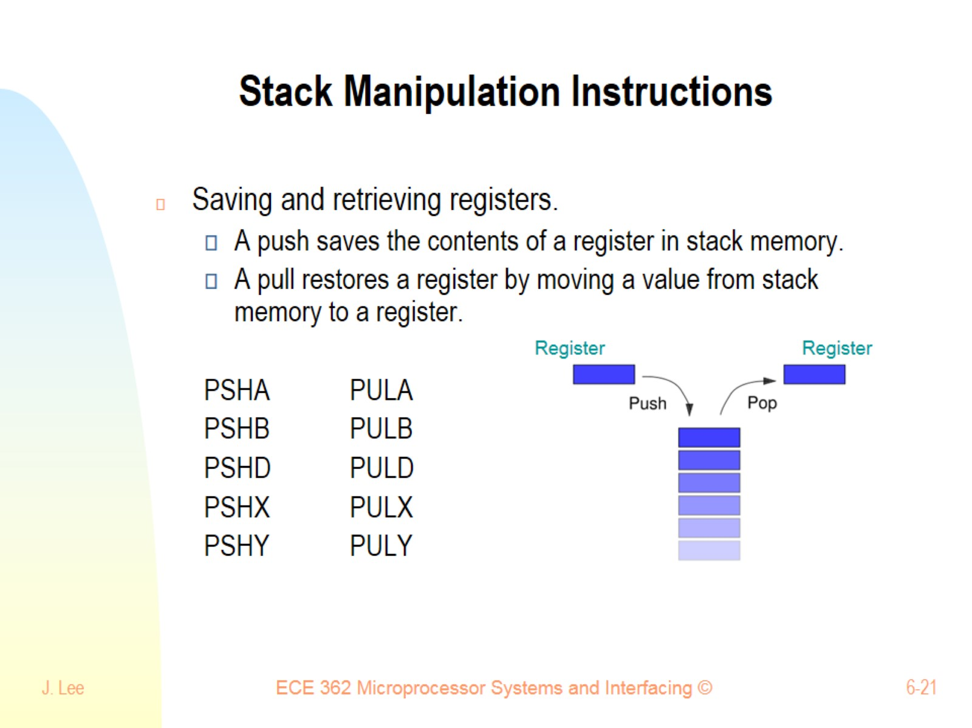
Stack Manipulation Instructions

Slide 22
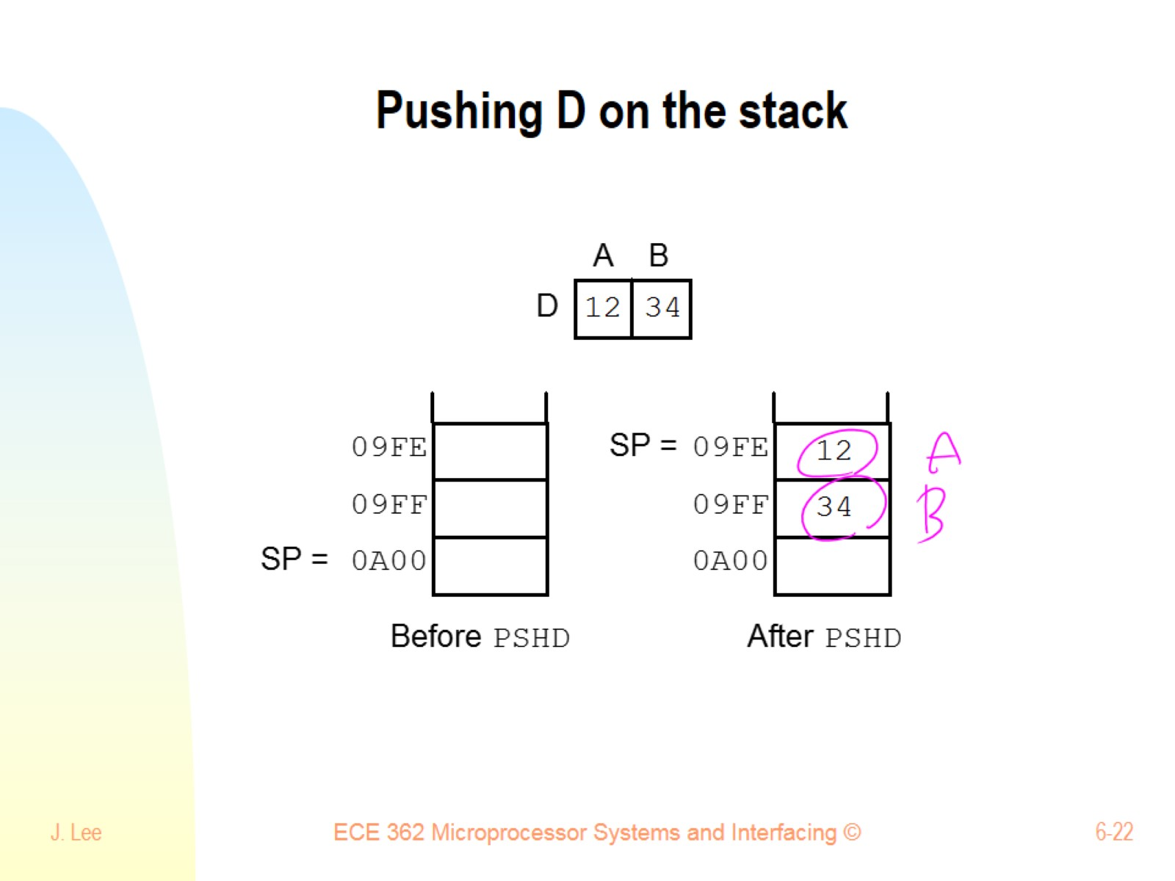
Pushing D on the stack

Slide 23
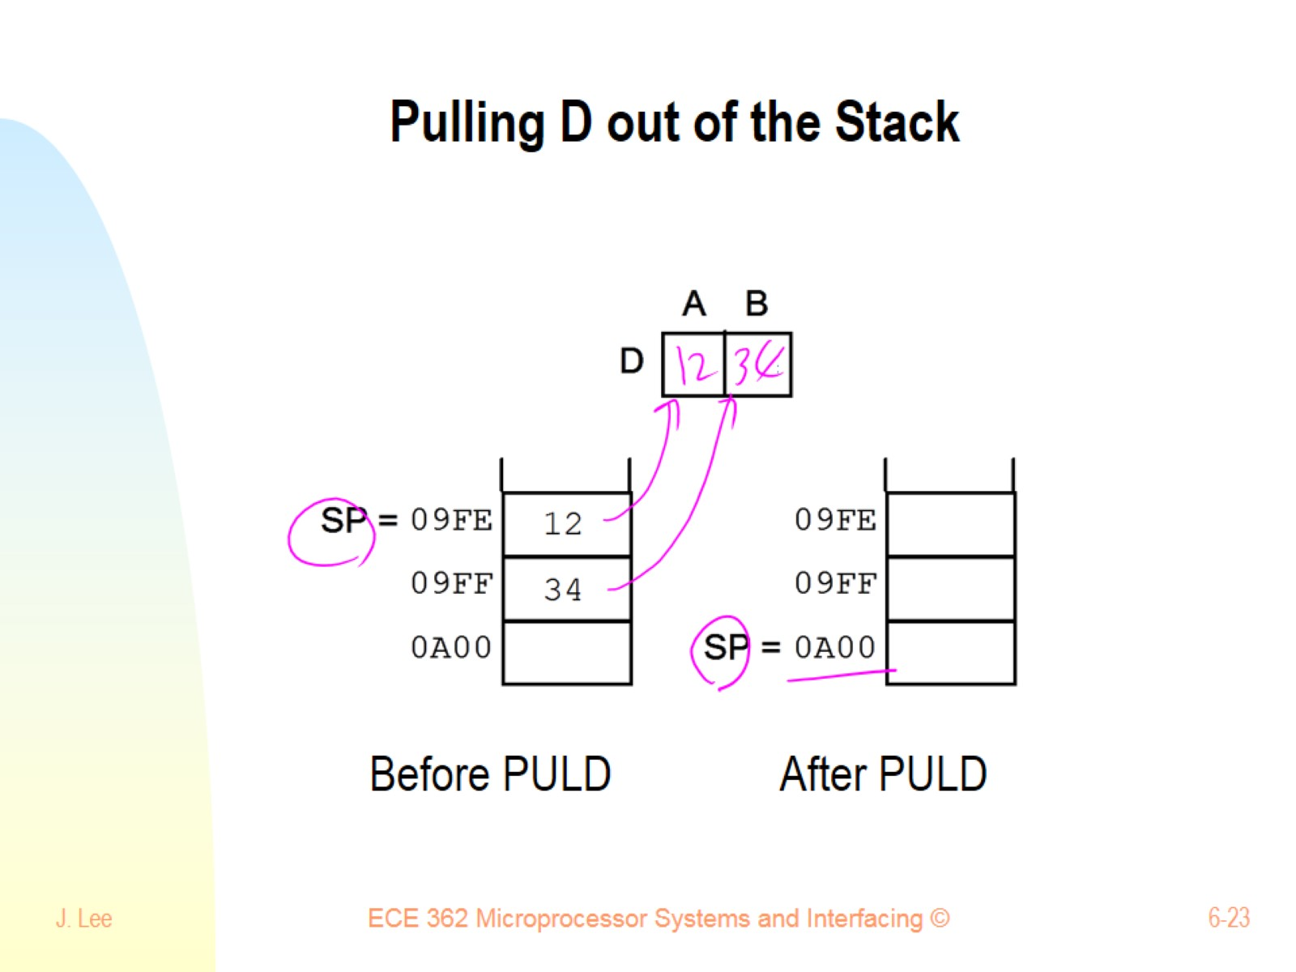
Pulling D out of the Stack

Slide 24
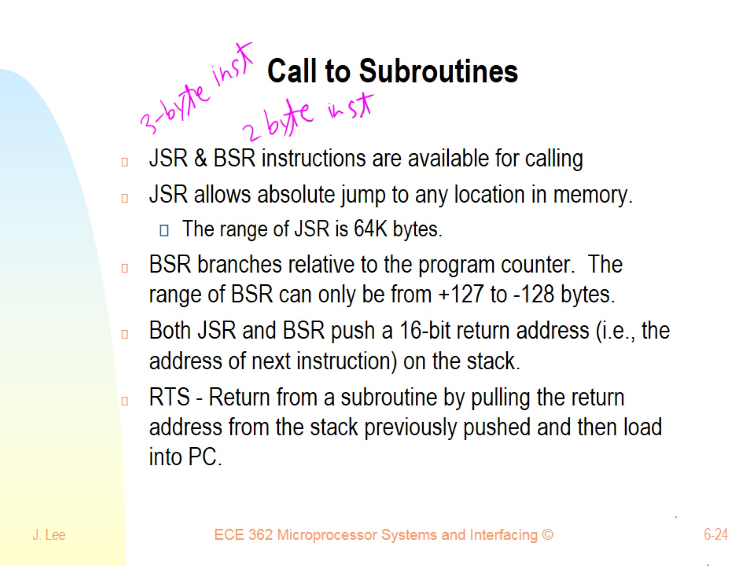
Call to Subroutines

Slide 25
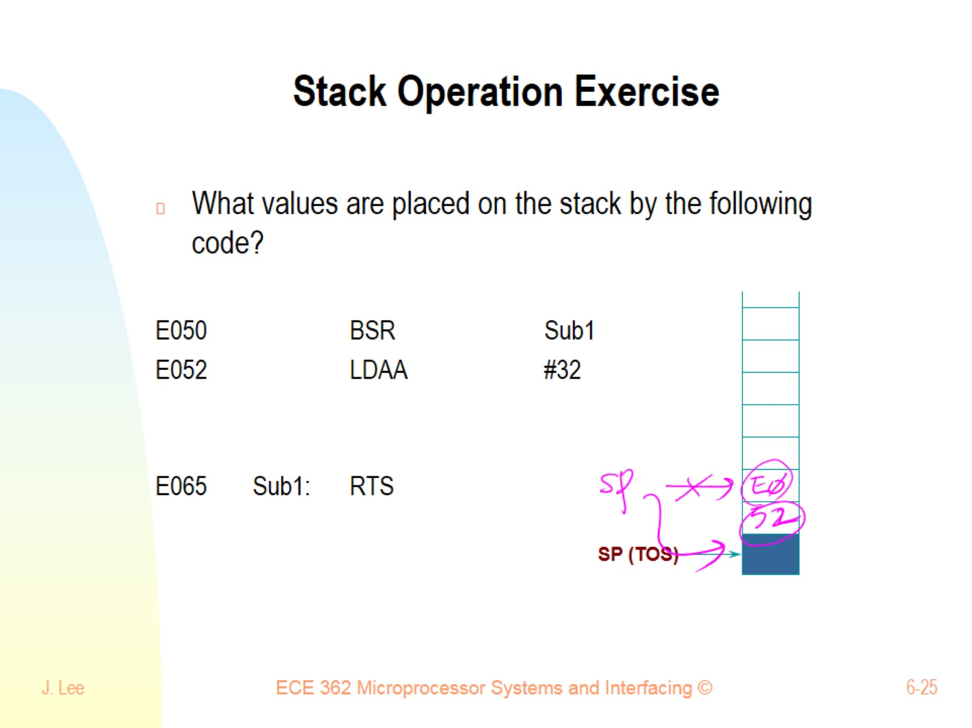
Stack Operation Exercise

Slide 26
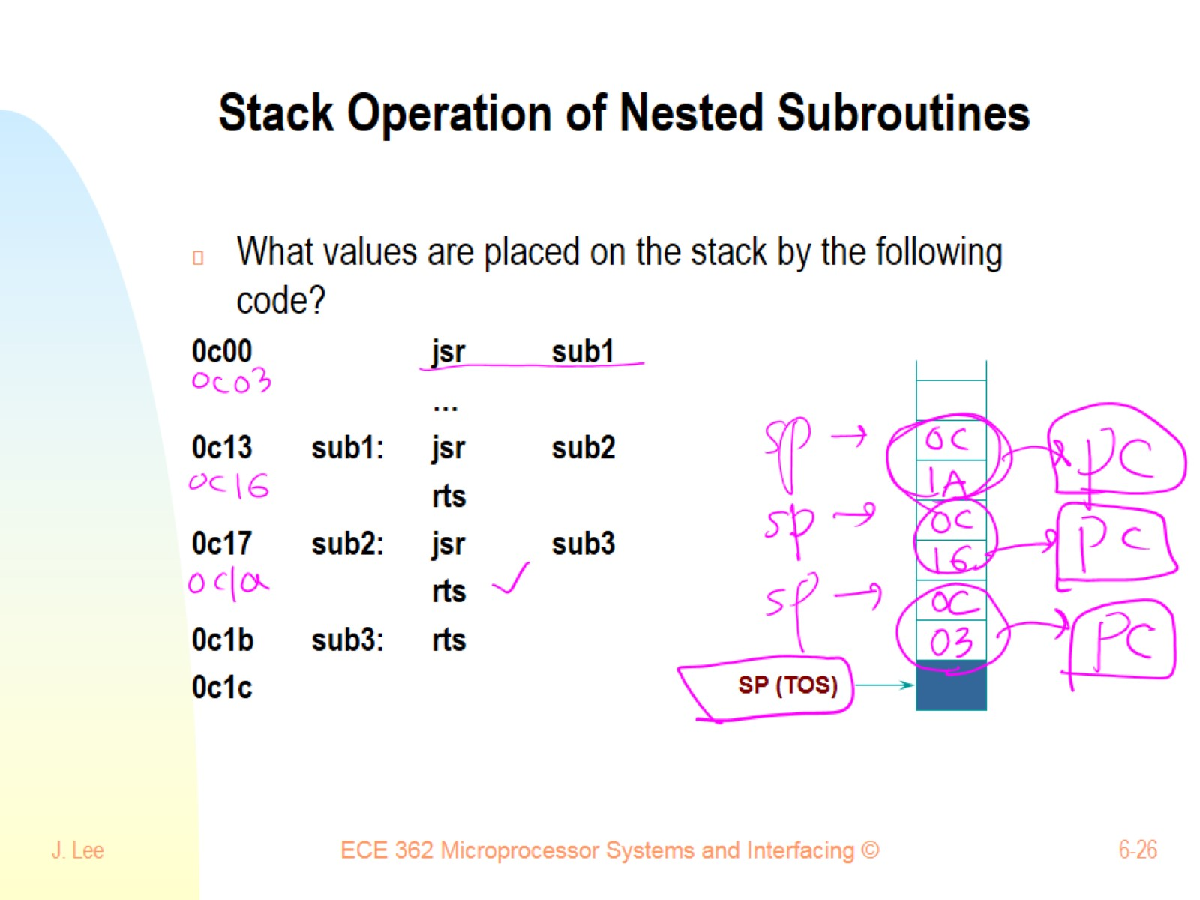
Stack Operation of Nested Subroutines

Slide 27
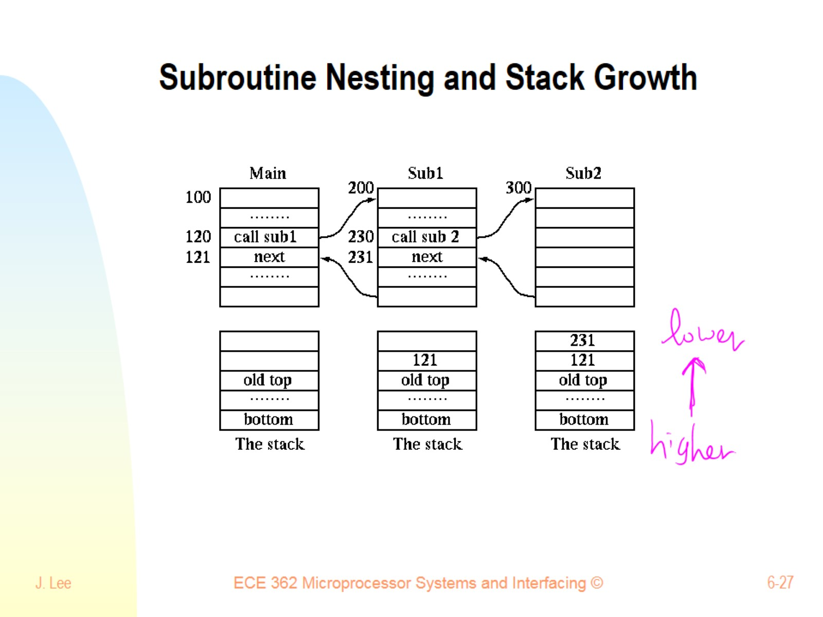
Subroutine Nesting and Stack Growth

Slide 28
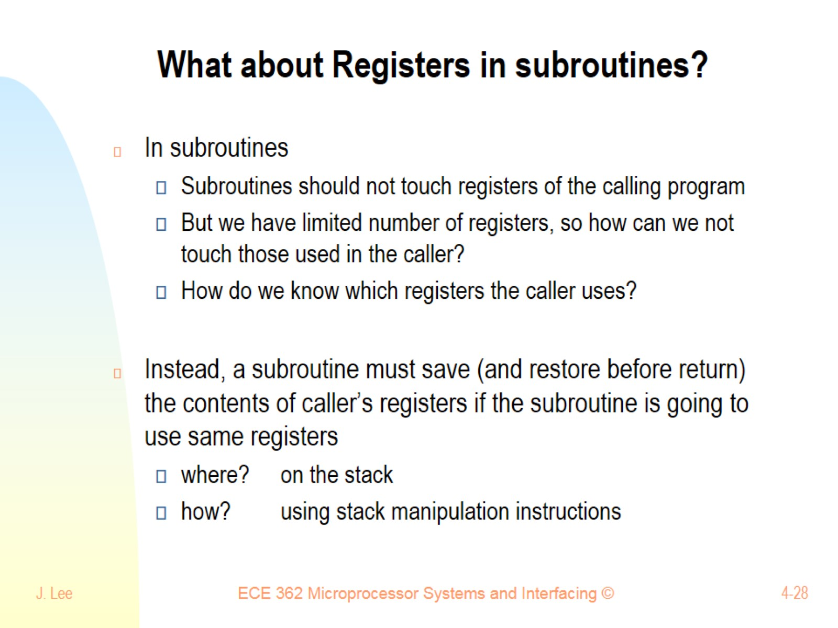
What about Registers in subroutines?

Slide 29
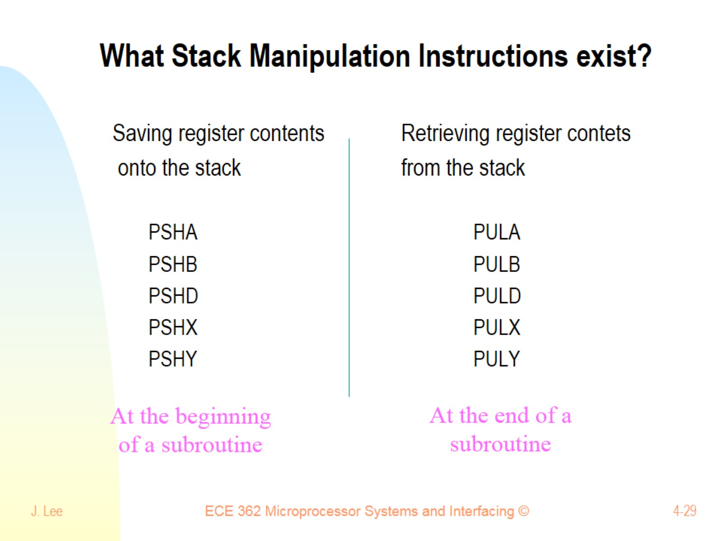
What Stack Manipulation Instructions exist?

Slide 30
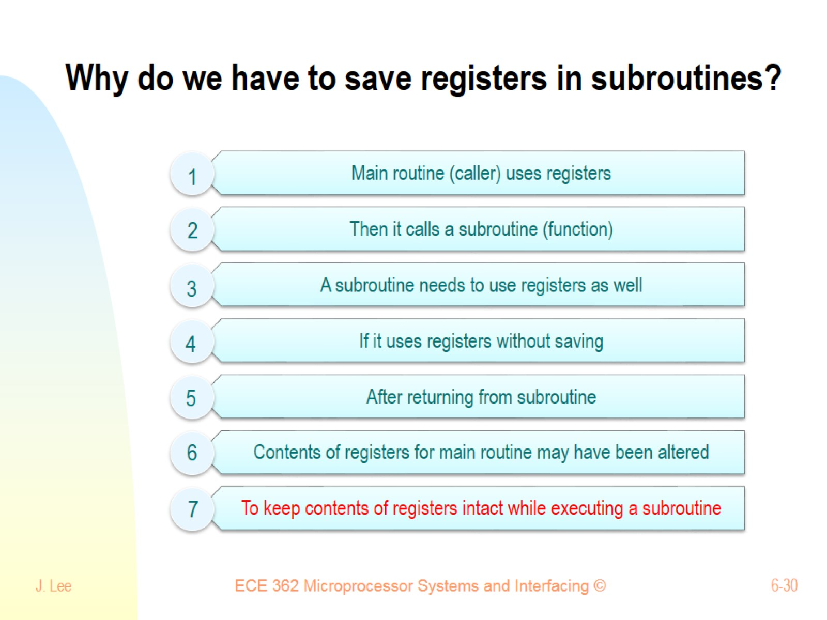
Why do we have to save registers in subroutines?

Slide 31
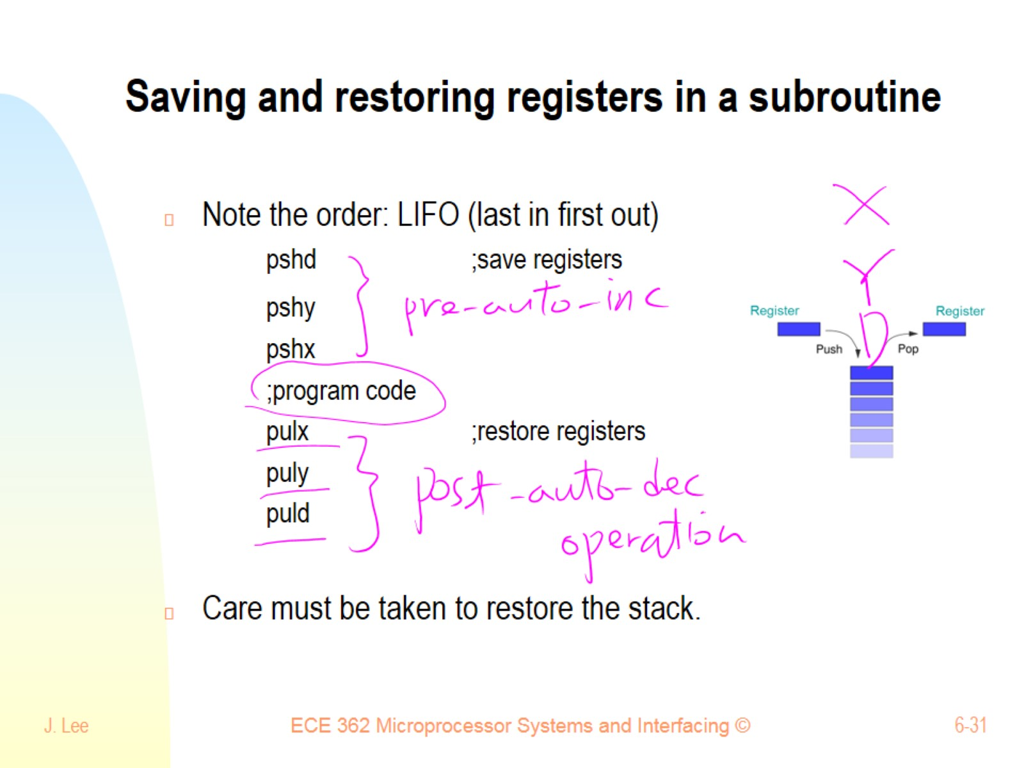
Saving and restoring registers in a subroutine

Slide 32
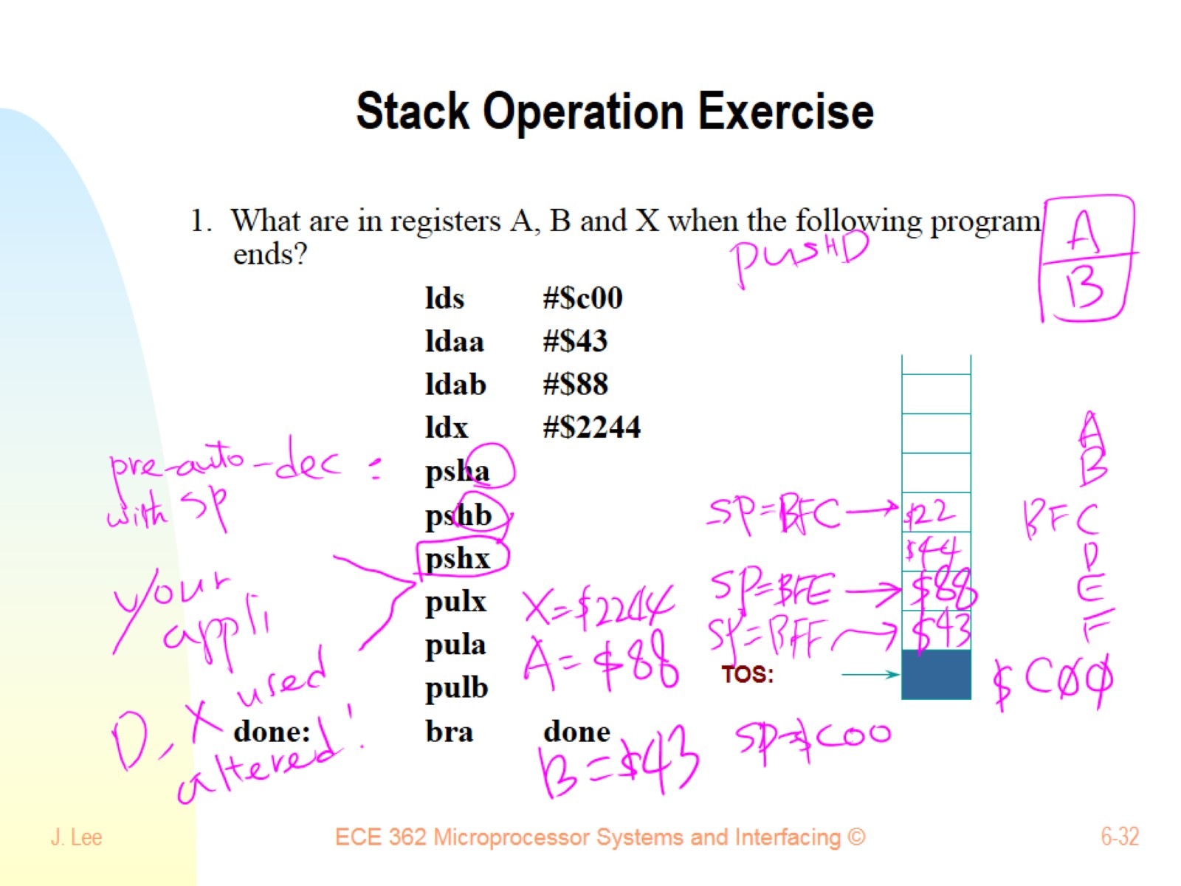
Stack Operation Exercise

Slide 33
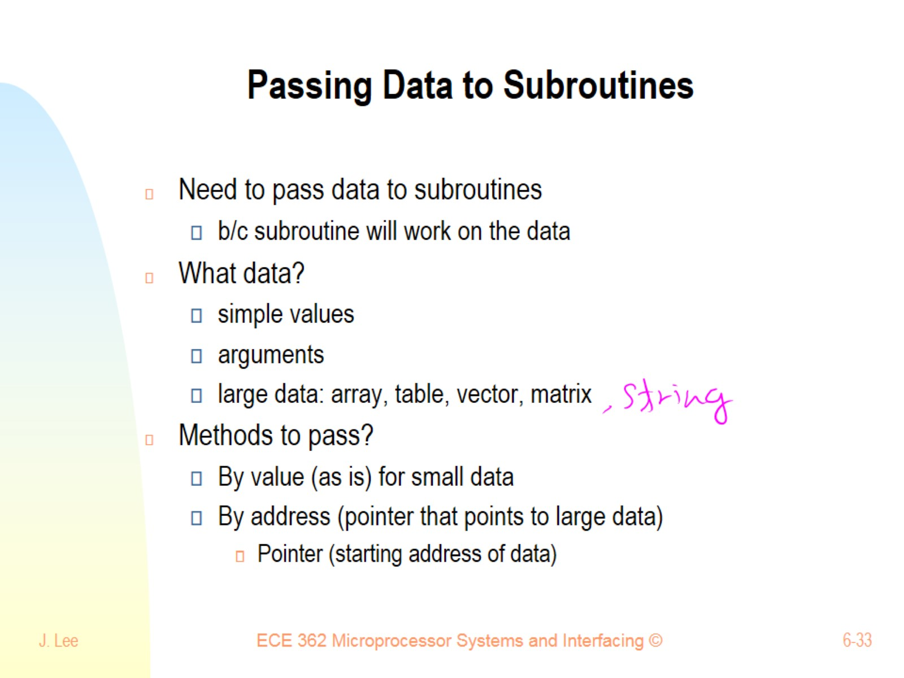
Passing Data to Subroutines

Slide 34
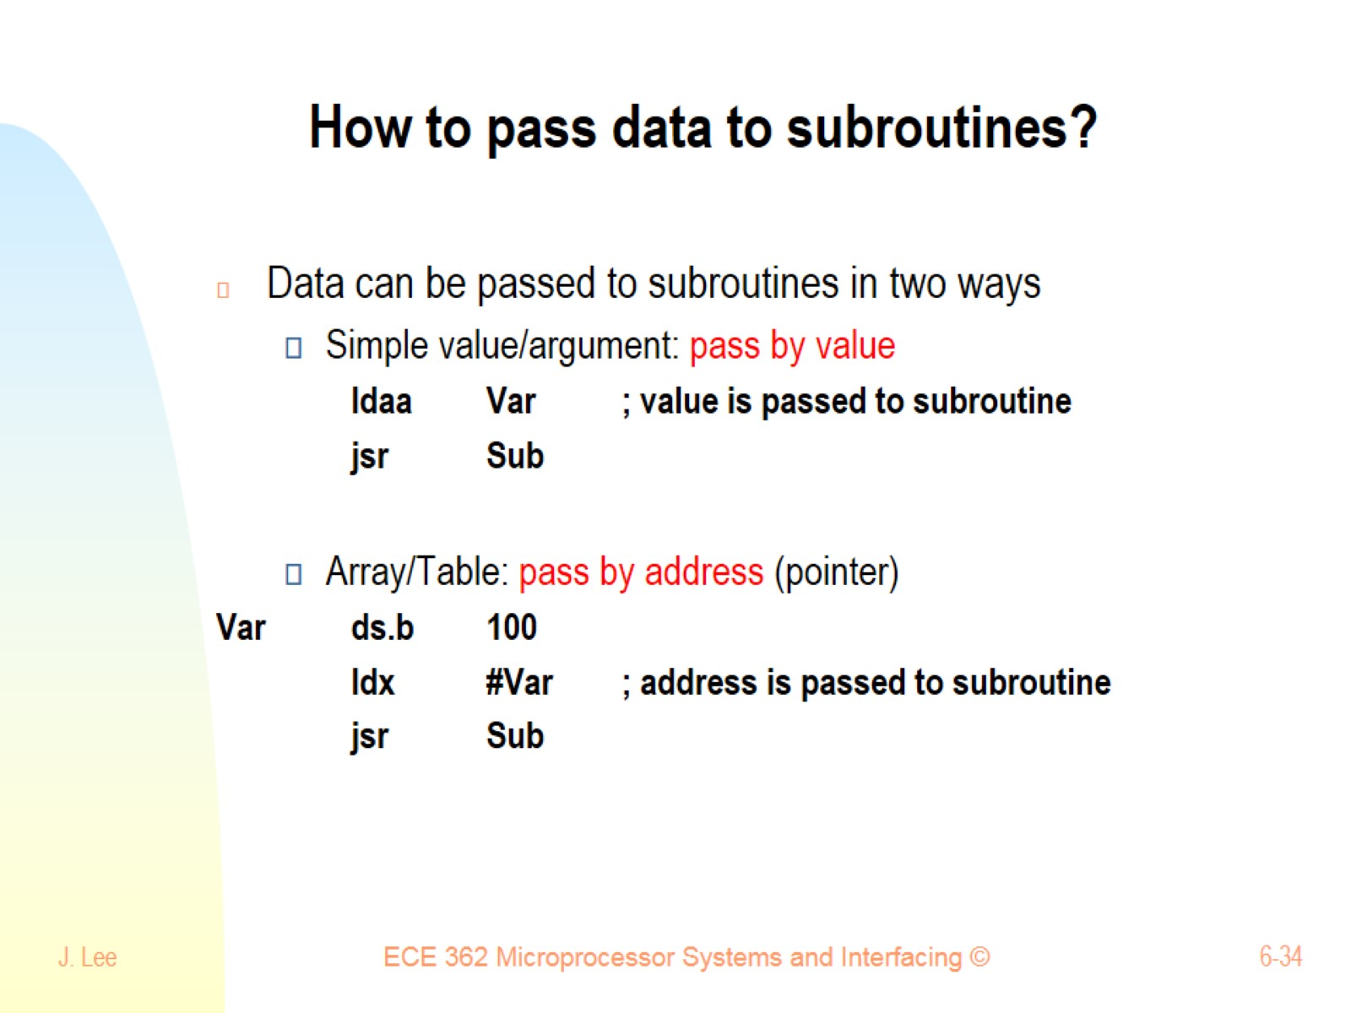
How to pass data to subroutines?

Slide 35
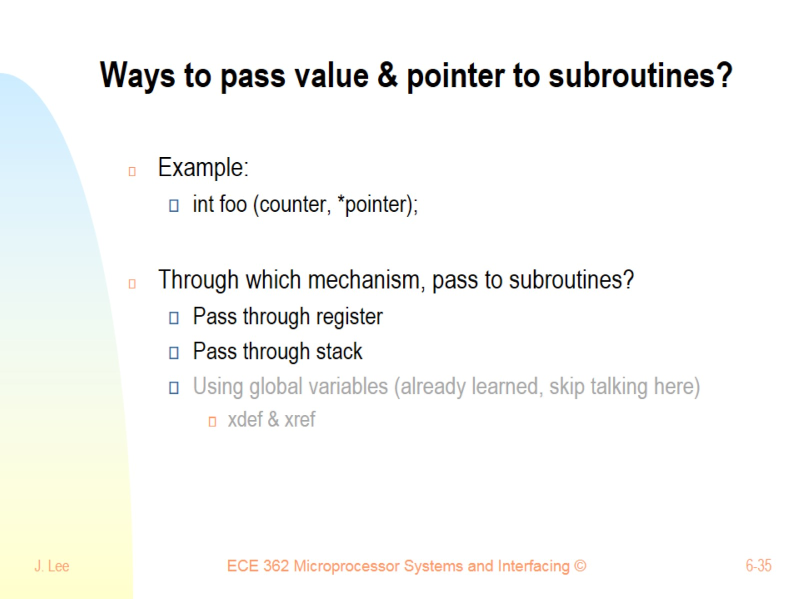
Ways to pass value & pointer to subroutines?

Slide 36
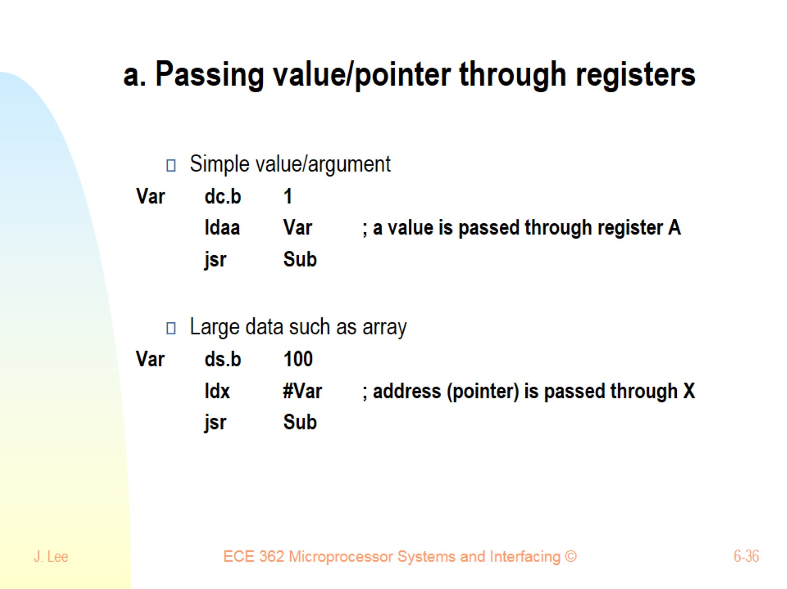
a. Passing value/pointer through registers

Slide 37
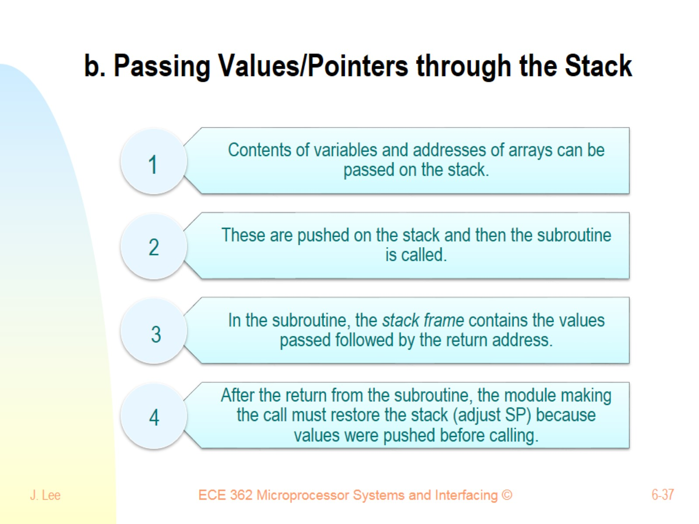
b. Passing Values/Pointers through the Stack

Slide 38
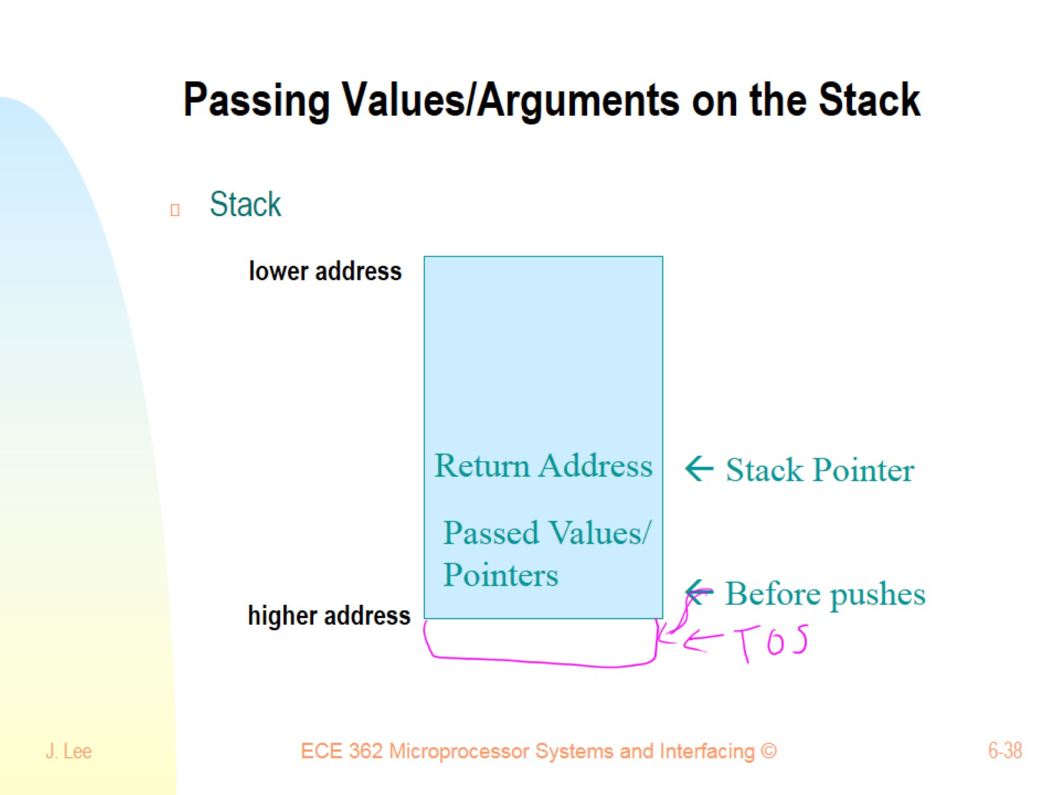
Passing Values/Arguments on the Stack

Slide 39
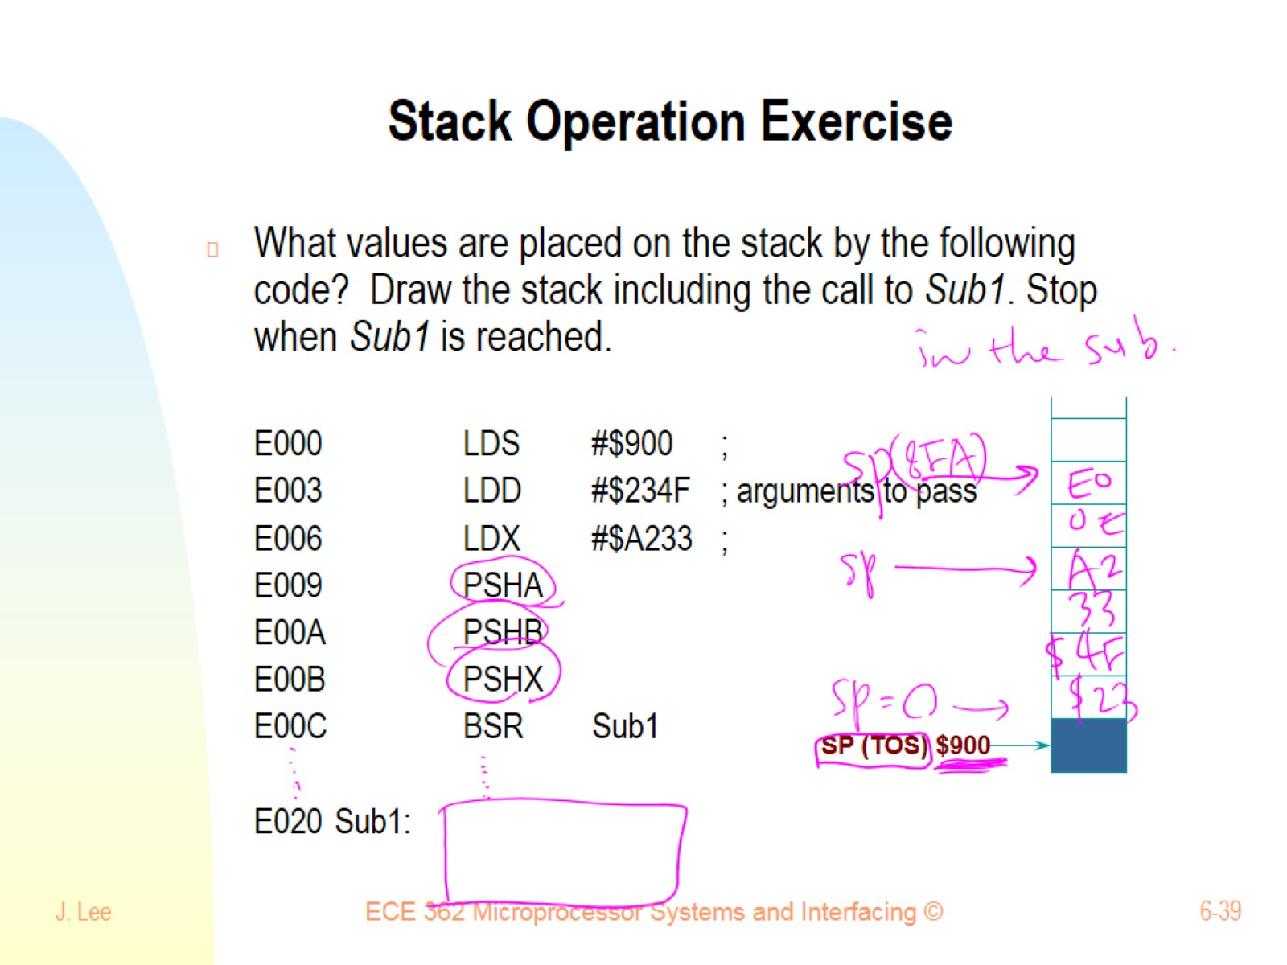
Stack Operation Exercise

Slide 40
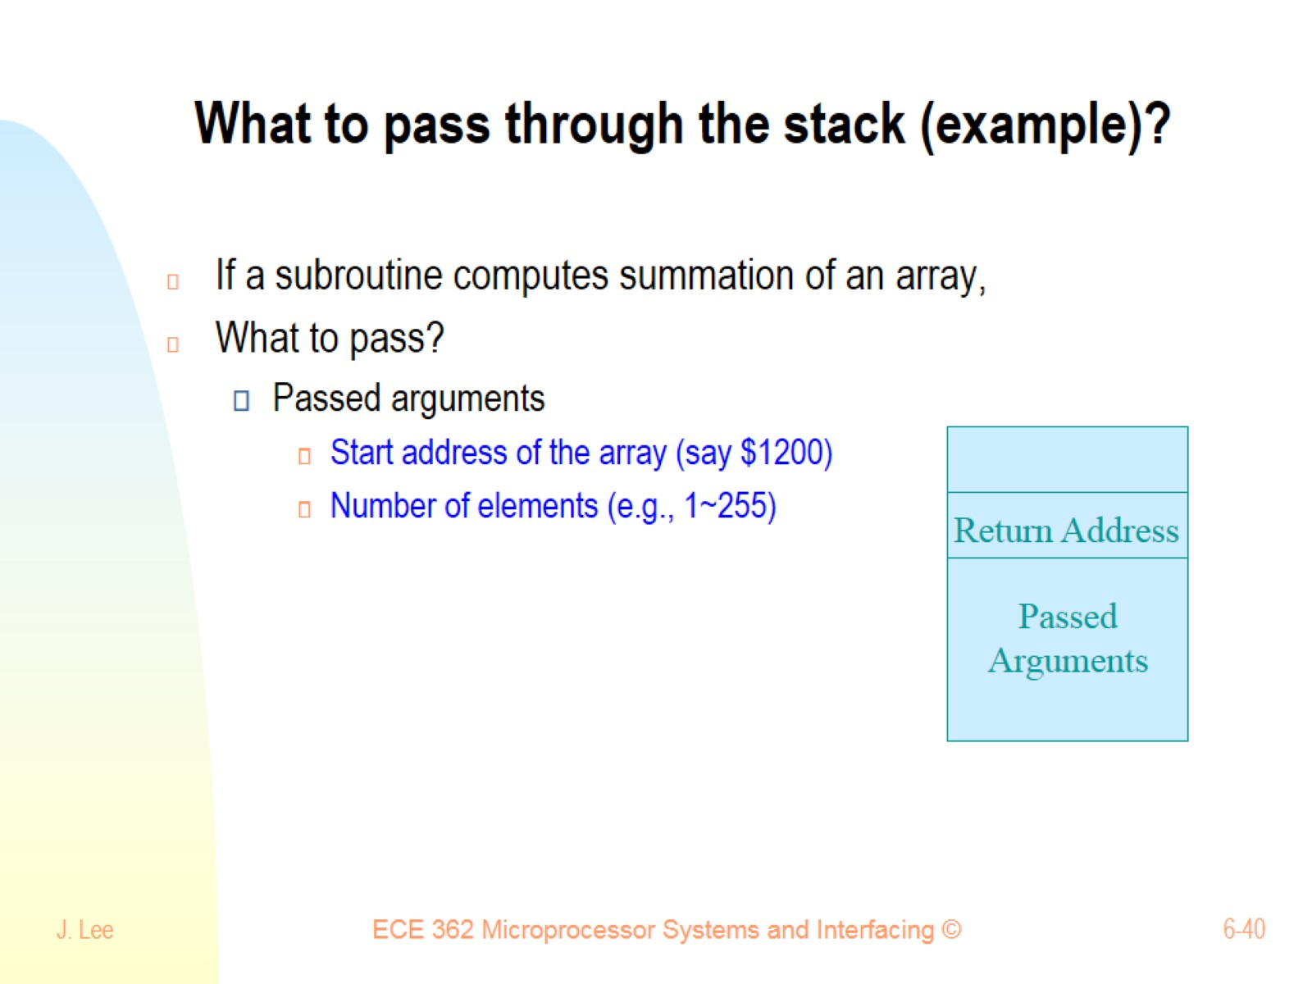
What to pass through the stack (example)?

Slide 41
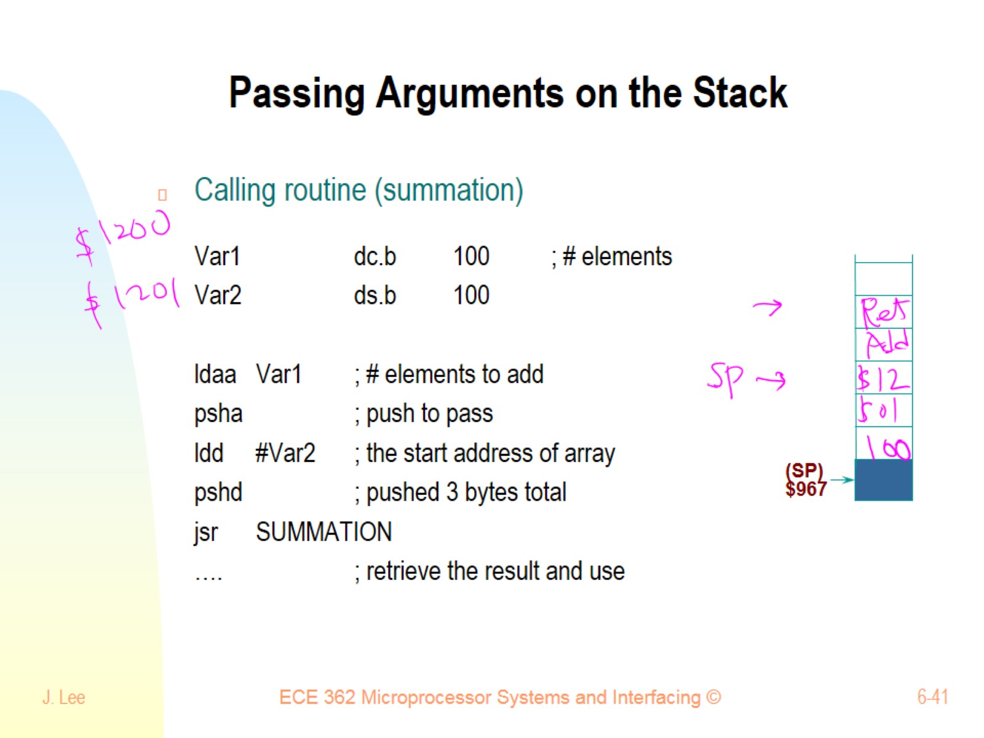
Passing Arguments on the Stack

Slide 42
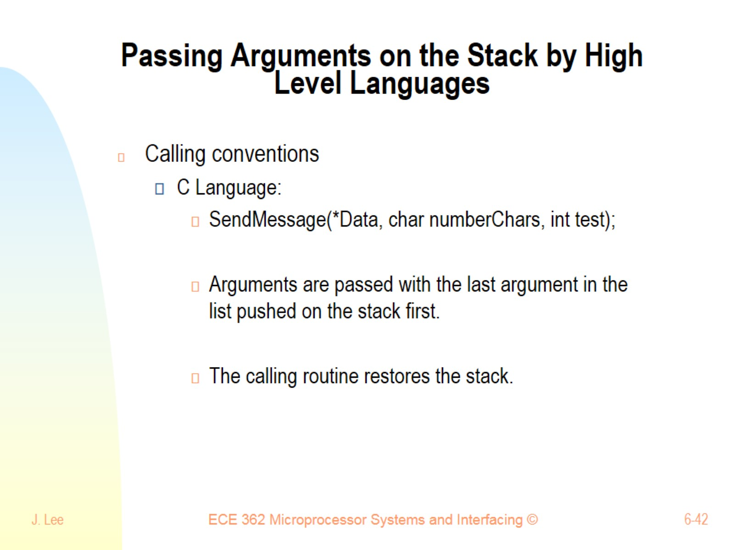
Passing Arguments on the Stack by High Level Languages

Slide 43
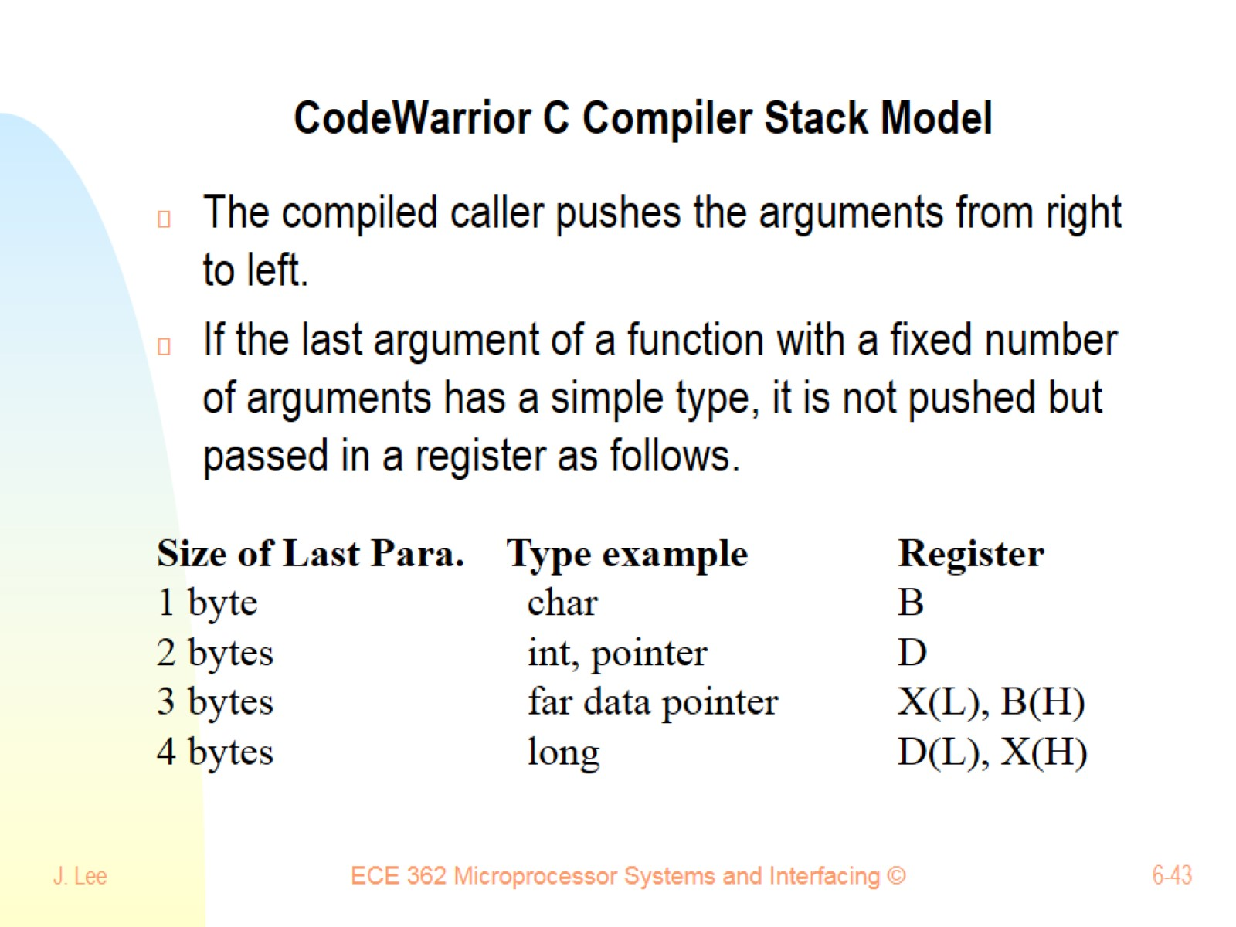
CodeWarrior C Compiler Stack Model

Slide 44
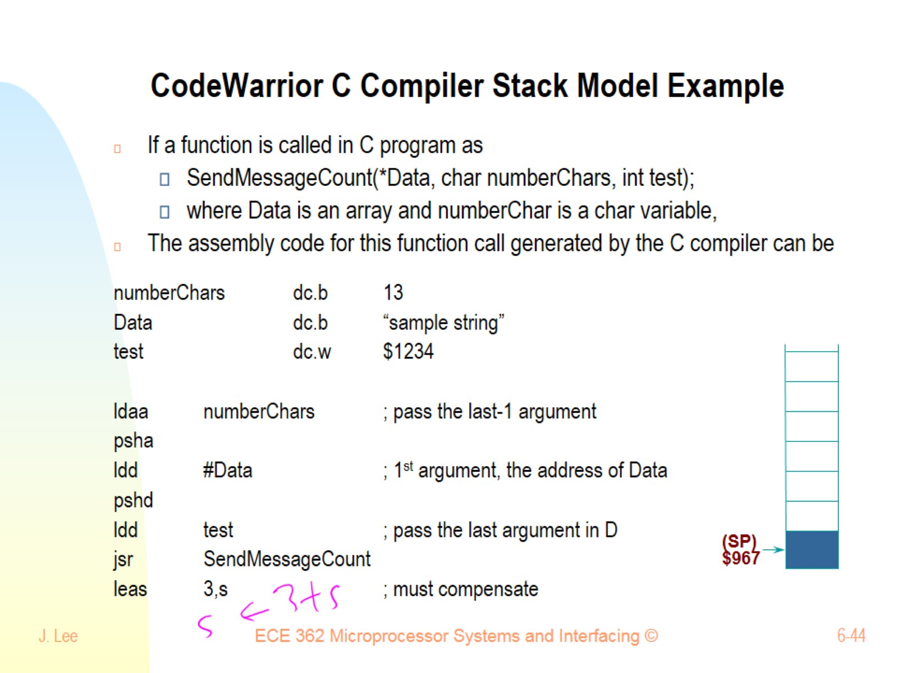
CodeWarrior C Compiler Stack Model Example

Slide 45
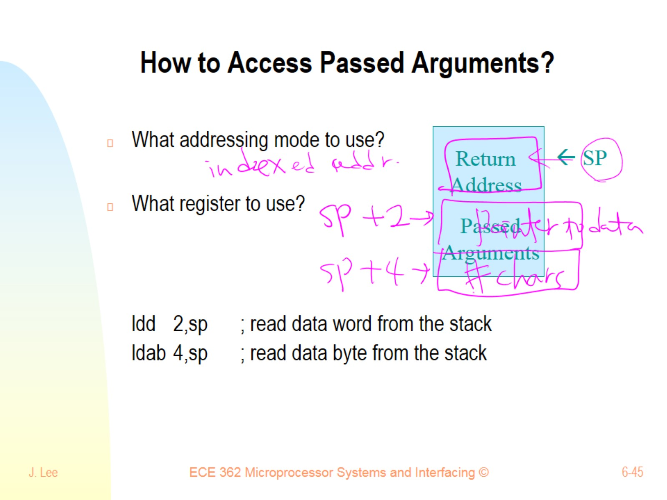
How to Access Passed Arguments?

Slide 46
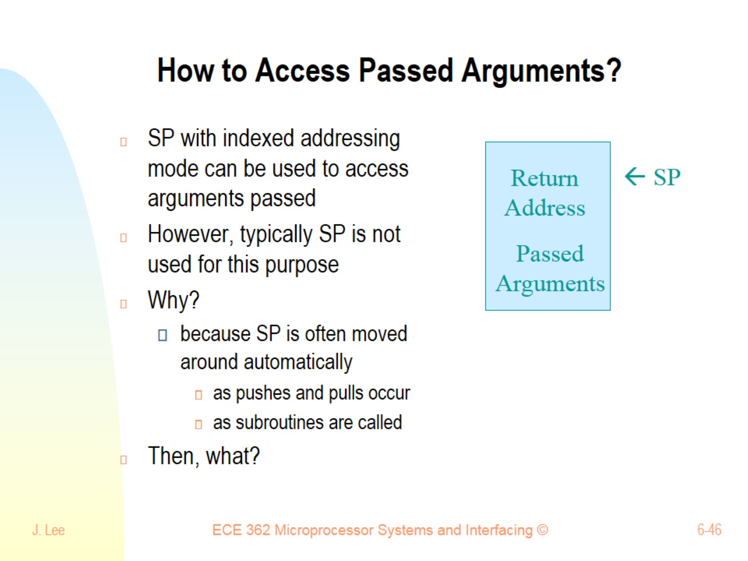
How to Access Passed Arguments?

Slide 47
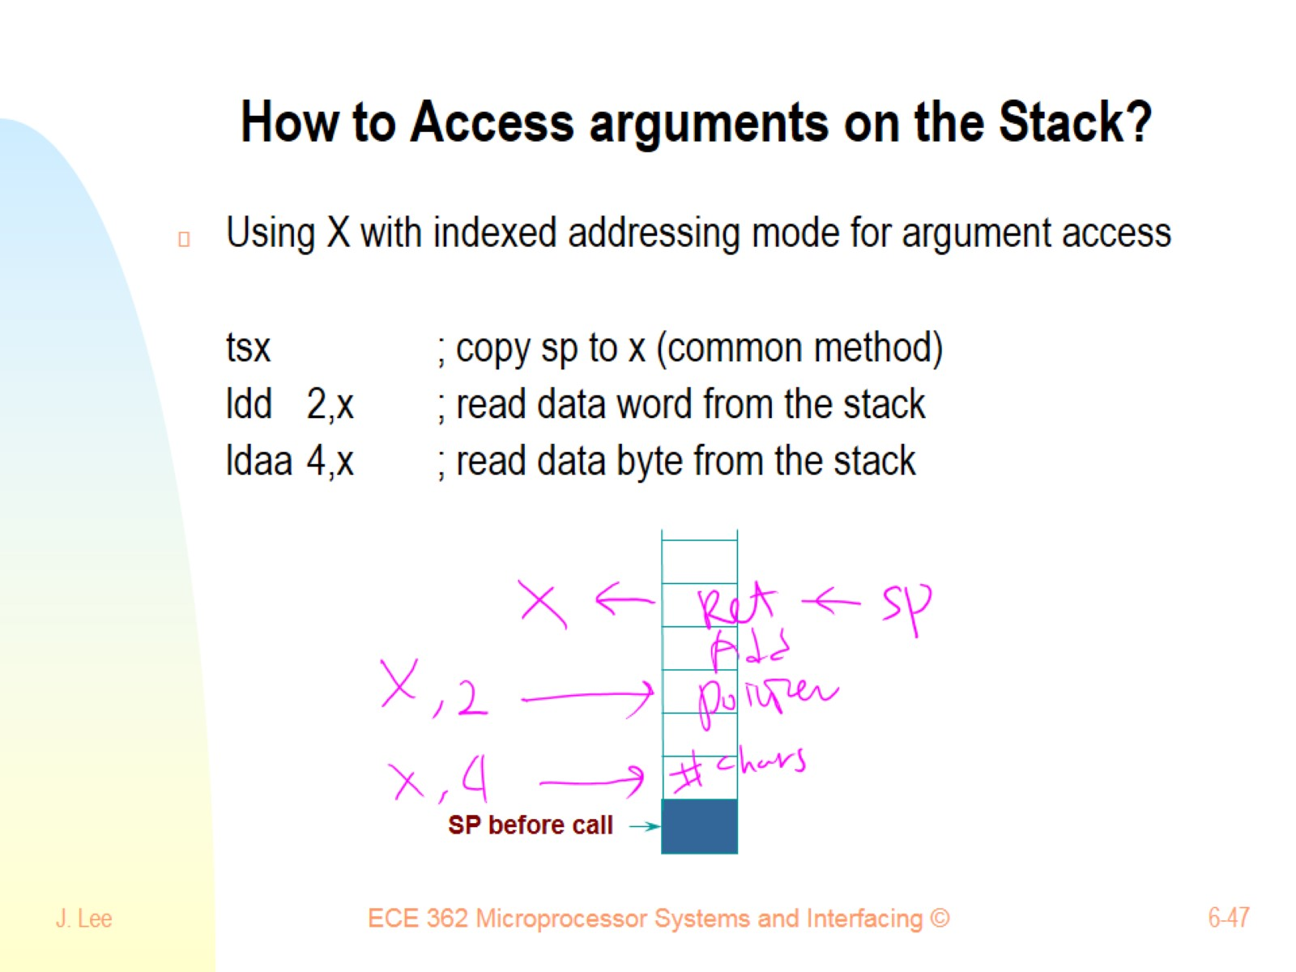
How to Access arguments on the Stack?

Slide 48
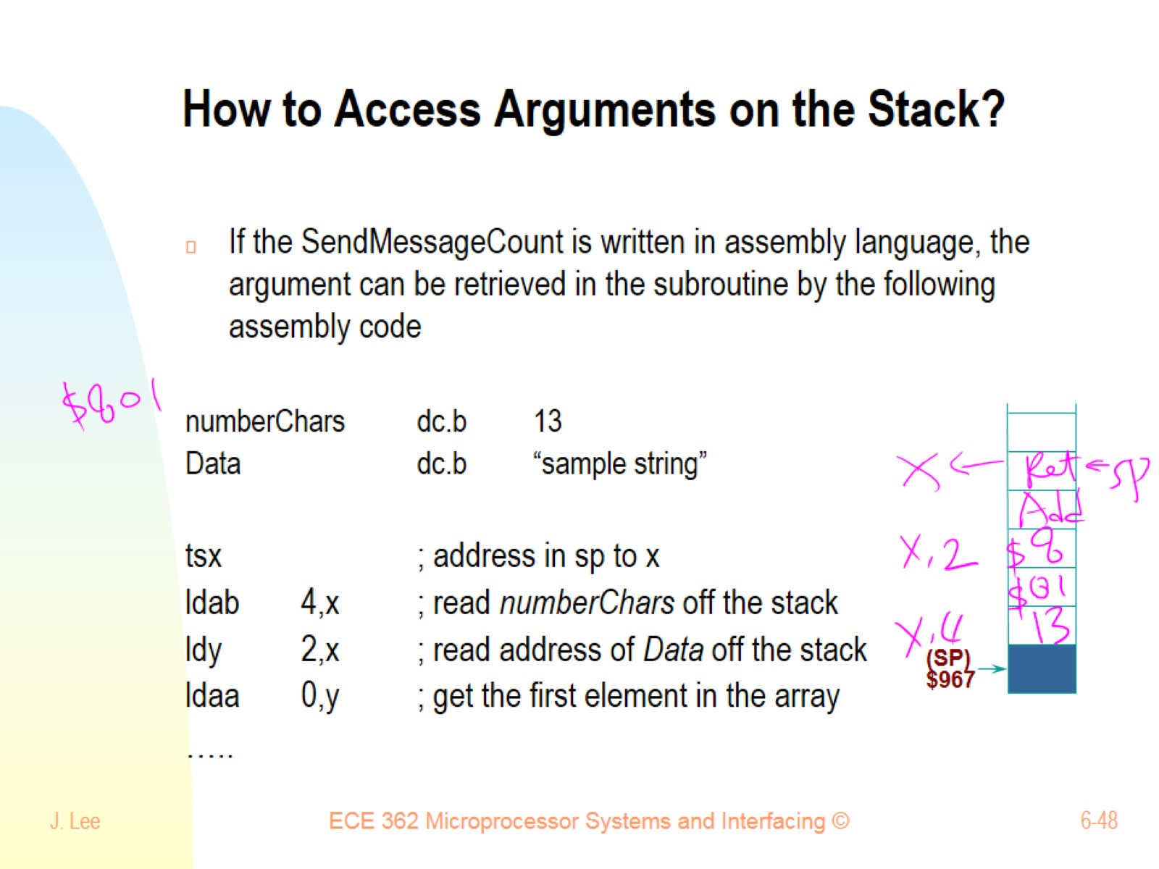
How to Access Arguments on the Stack?

Slide 49
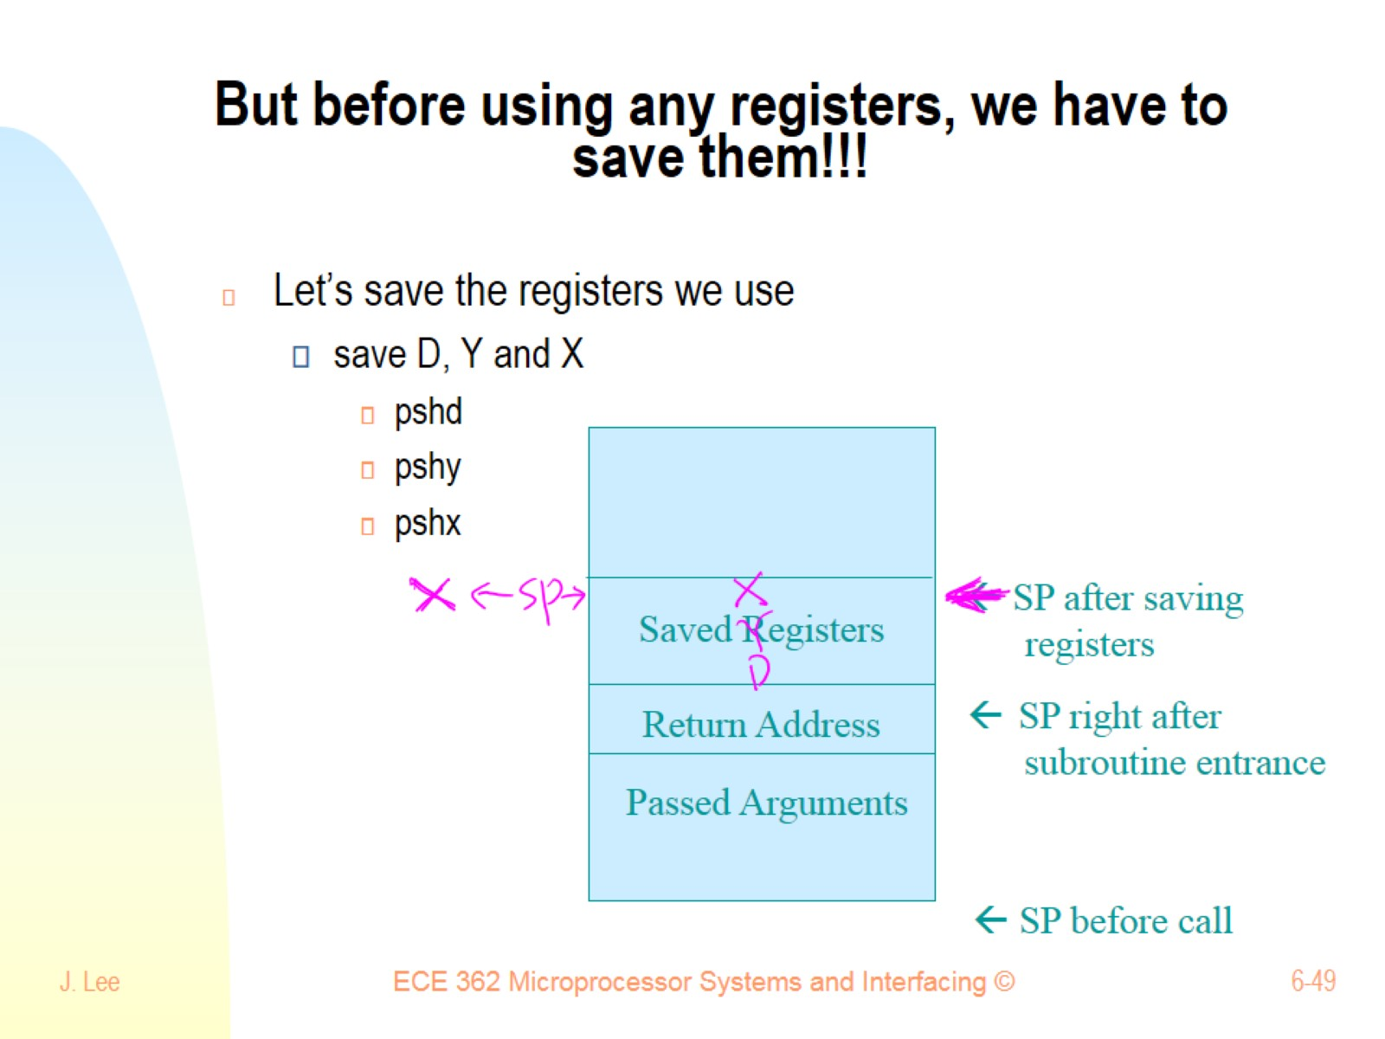
But before using any registers, we have to save them!!!

Slide 50
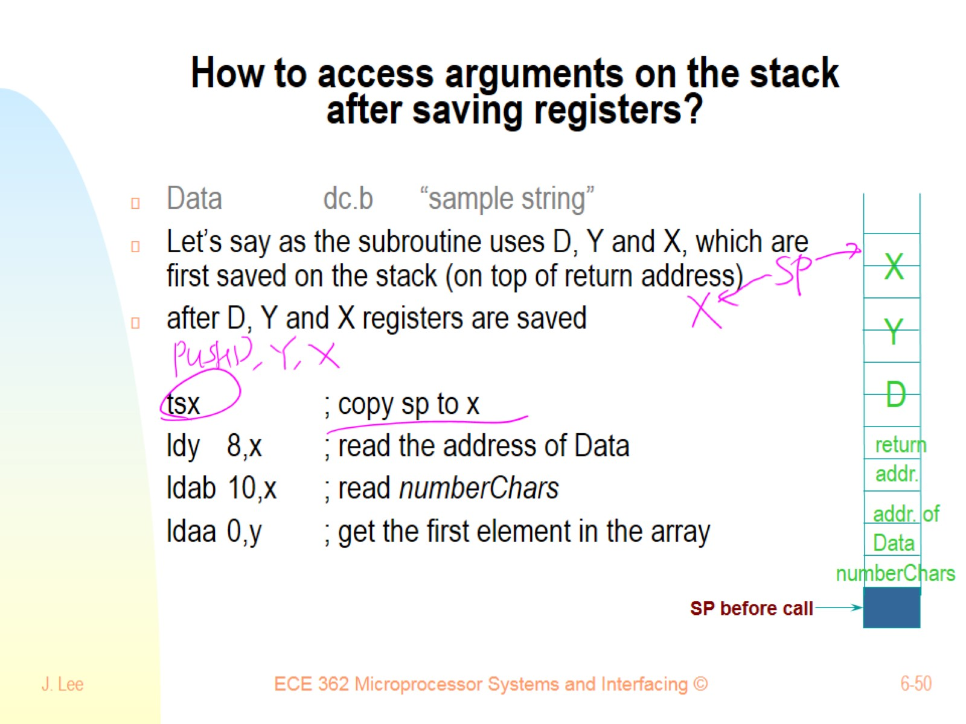
How to access arguments on the stack after saving registers?

Slide 51

How to access arguments on the stack after saving registers?

Slide 52

How to return results back?

Slide 53

Return result(s) through register(s)

Slide 54

Return result(s) through stack

Slide 55

How to access result passed on the Stack?

Slide 56

Comparing two strings using a subroutine

Slide 57

Subroutine comparing two strings

Slide 58

More Subroutines/Stack

Slide 59

What should be the good size of Stack?

Slide 60

Local Variables (of C) on the Stack

Slide 61

Local Variables (C like) on the Stack

Slide 62

Local Variables (C like) on the Stack

Slide 63

What’s Stack Frame?

Slide 64

What does the Stack Frame contain?

Slide 65

One stack frame for each subroutine call

Slide 66

Why should we use Frame Pointer?

Slide 67

How to use Frame Pointer?

Slide 68

Reentrancy

Slide 69

Reentrant Subroutine Example

Slide 70

Recursion Example:

Slide 71

PopQuiz 5 Recursion

